Slide 1
Global Economics & Markets
Bob Cunneen
Senior Economist
October 2025

Slide 2
Important information
Important information
This communication is provided by MLC Investments Limited (ABN 30 002 641 661, AFSL 230705) (MLC), part of the Insignia Financial Group of companies (comprising Insignia Financial Ltd, ABN 49 100 103 722 and its related bodies corporate) (‘Insignia Financial Group’).
An investment with MLC does not represent a deposit or liability of, and is not guaranteed by, the Insignia Financial Group.
This information may constitute general advice. It has been prepared without taking account of an investor's objectives, financial situation or needs and because of that an investor should, before acting on the advice, consider the appropriateness of the advice having regard to their personal objectives, financial situation and needs.
Past performance is not a reliable indicator of future performance. Share market returns are all in local currency.
Any opinions expressed in this communication constitute our judgement at the time of issue and are subject to change. We believe that the information contained in this communication is correct and that any estimates, opinions, conclusions or recommendations are reasonably held or made as at the time of compilation. However, no warranty is made as to their accuracy or reliability (which may change without notice), or other information contained in this communication.
This information is directed to and prepared for Australian residents only.
MLC may use the services of any member of the Insignia Financial Group where it makes good business sense to do so and will benefit customers. Amounts paid for these services are always negotiated on an arm's length basis. MLC relies on third parties to provide certain information and is not responsible for its accuracy, nor is MLC liable for any loss arising from a person relying on information provided by third parties.
Bloomberg Finance L.P. and its affiliates (collectively, “Bloomberg”) do not approve or endorse any information included in this material and disclaim all liability for any loss or damage of any kind arising out of the use of all or any part of this material.
The funds referred to herein is not sponsored, endorsed, or promoted by MSCI, and MSCI bears no liability with respect to any such funds.

Slide 3
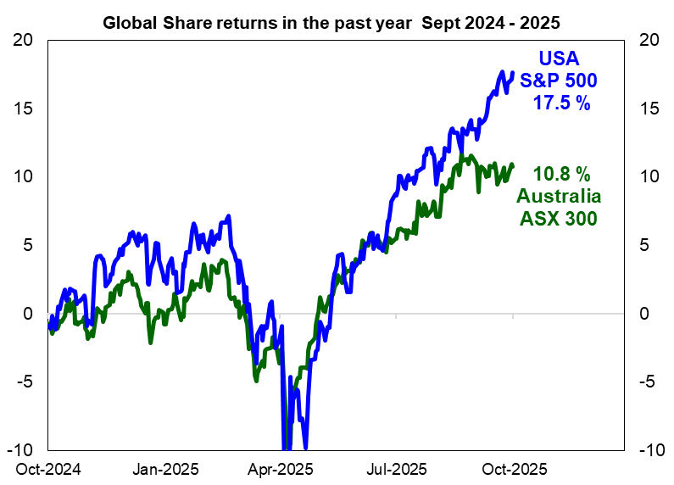
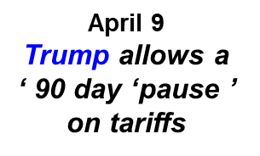
American and Australian share prices have made new historic highs and have delivered strong returns in the past year.
President Trump takes office
January
Trump announces large tariffs increases in March & April
RBA cuts interest rates in Feb, May & August

Slide 4
RBA is concerned that global financial markets may be complacent on risks
“ Despite rising geopolitical tension, and fiscal sustainability challenges in a number of large advanced economies, risk premiums in global equity and credit markets remain low, and sovereign bond term premia are only around long-term averages.
Forward-looking measures of financial market volatility are also generally subdued.
A reassessment of the likelihood or consequences of key risks materialising would therefore make international financial markets vulnerable to sharp corrections.”
Source : Reserve Bank of Australia Financial Stability Review , October 2025 page 5 (RBA)

Slide 5
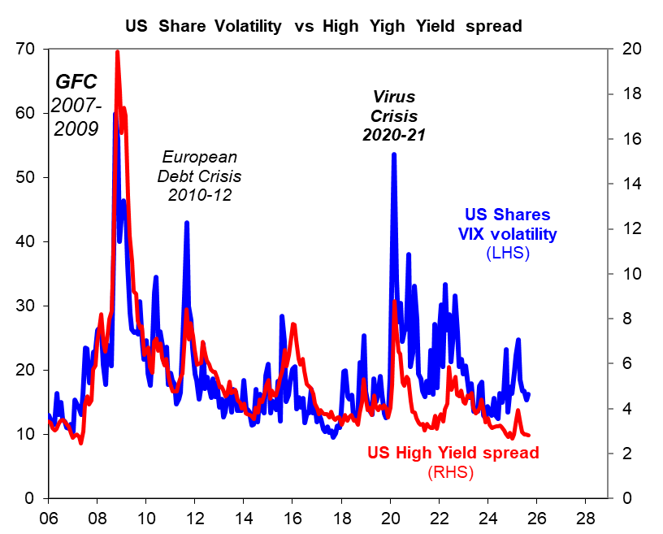

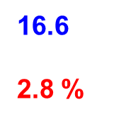
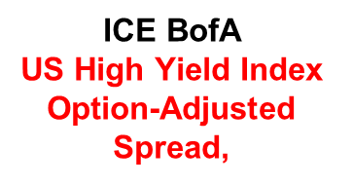
Financial markets are exuberant and ‘risk on’ as evidenced by the low VIX share market volatility reading and US High Yield credit spreads
20 year averages 2005-2024
VIX
19.1 %
High Yield
5.1%

Slide 6
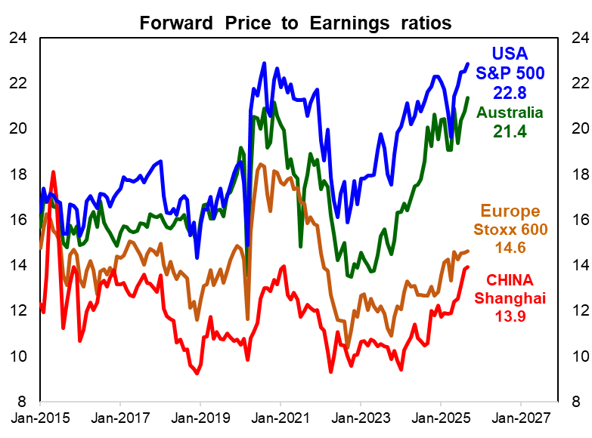
Australian and US shares have achieved record highs this year. However expensive valuations as suggested by high Forward P/E ratios suggest further gains may be limited.
Decade average Forward Price to Earnings
USA
S&P 500
18.3
Australia
16.5
Europe
14.1
CHINA
11.1
2015 – 2024
IBES data

Slide 7
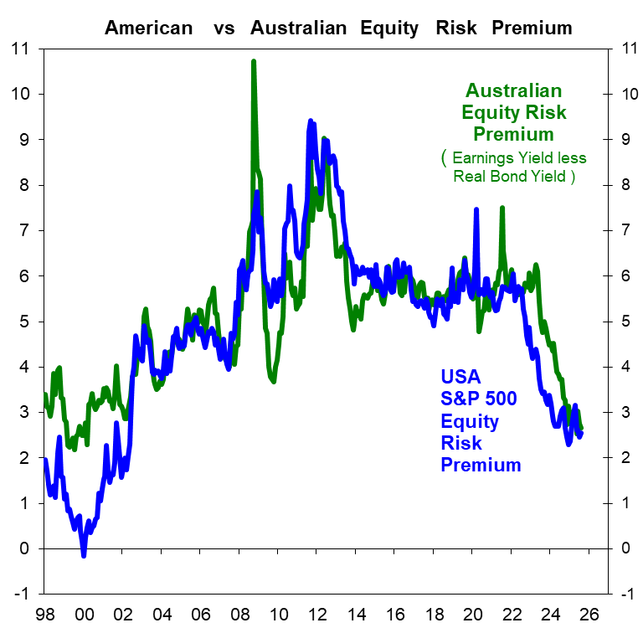
Equity risk premiums are extraordinarily low for American & Australian Shares
Equity Risk Premium is the Forward Earnings Yield on Shares less the 10 year Real Government
Bond Yield or equivalent.
The Forward Earnings Yield is the inverted Price to Earnings ratio
Average
Equity Risk
Premium
1998 - 2024
Australia
5.1 %
USA
4.9 %
GFC
2007-09
Average
Equity Premium
5 %
 | Forward PE | Earnings Yield | Real Bond | Equity premium
USA | 22.8 | 4.39 | 1.78 | 2.6
Aus | 21.4 | 4.67 | 2.0 | 2.7

Slide 8
President Trump in April 2025 : “ I always say ‘ tariffs' is the most beautiful word to me in the dictionary ” *
Tariffs | 2024 under President Biden | Trump’s ‘Liberation Day April 2 to April 8 pronouncements | Current October 2025
AUSTRALIA | 0 % | 10 % | 10 %
EUROPE | 2 % | 20 % | 15 %
CHINA | 16 % | 145 % | 30 %
JAPAN | 2 % | 25 % | 15 %
Aluminium & Steel | 25% China & Mexico | 25 % all countries | 50 % All
Autos & parts | N/A | 25 % | 15 %
USA Effective Tariff rate | 2.4 % | 24 % | 17.9 %
Source NPR https://www.npr.org/2025/04/09/nx-s1-5355661/tariffs-history-meaning , World Trade Organisation for 2024 data World Tariff Profiles
and Yale University Budget Labs

Slide 9
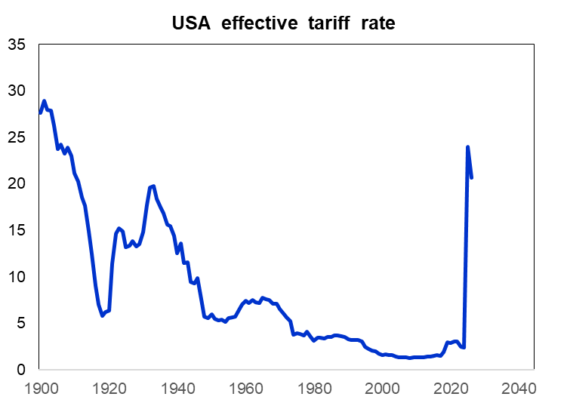
“Back to the Future” for US trade policy : American consumers confront an “average effective tariff rate of 17.9 % according to the Yale University’s Budget Lab.
17.9 %
Source
Yale University Budget Lab : https://budgetlab.yale.edu/research/state-us-tariffs-july-14-2025

Slide 10
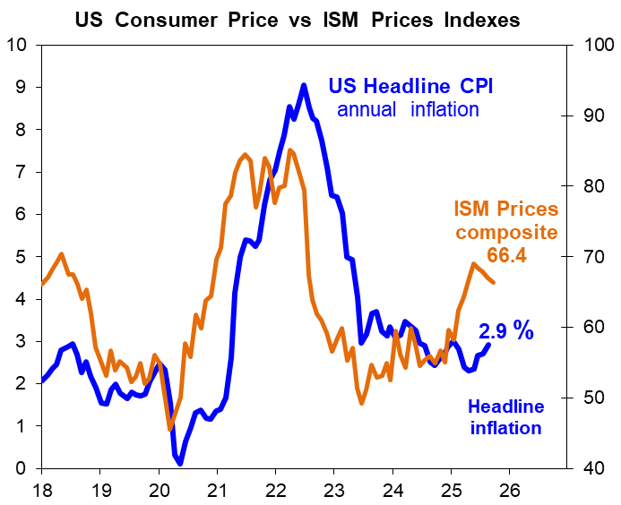
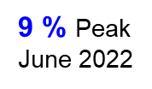
US consumer inflation data suggests that price pressures are building given the impact of President Trump’ s tariffs. US Headline annual inflation was 2.9 % in August.
Federal Reserve Chair
Jerome Powell noted
on September 17 ^{th} :
“ Higher tariffs have begun to push up prices in some categories of goods, but their overall effects on economic activity and inflation remain to be seen.
A reasonable base case is that the effects on inflation will be relatively short lived—
a one-time shift in the price level. But it is also possible that the inflationary effects could instead be more persistent. ”

Slide 11
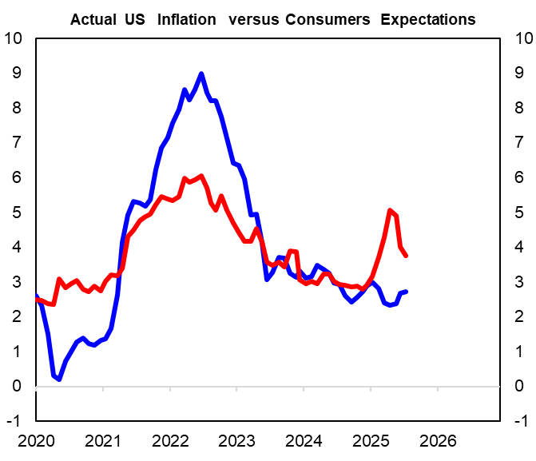
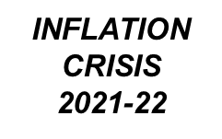
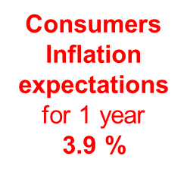
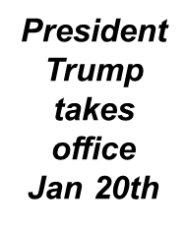

American consumers are also wary on inflation given President Trump’s tariff agenda
9 % Peak
June 2022
USA Consumer Price Index annual change
Source
Federal Reserve
St Louis (FRED)
April 2025
Tariffs 5.1 %
2.9 % AUG
Actual inflation
Consumer’s inflation expectation is an average of
FED New York and the University of Michigan surveys for 1 year.
USinflationrisk.xls

Slide 12
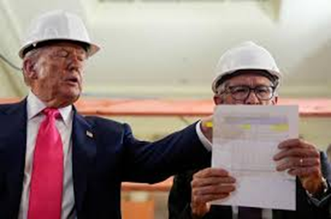
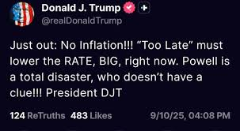
President Trump’s diplomatic skills with Federal Reserve Chair Jerome Powell
President Trump
nominated Powell to be the FED Chair in 2018 and Republicans in Congress approved
Powell’s
appointment.

Slide 13
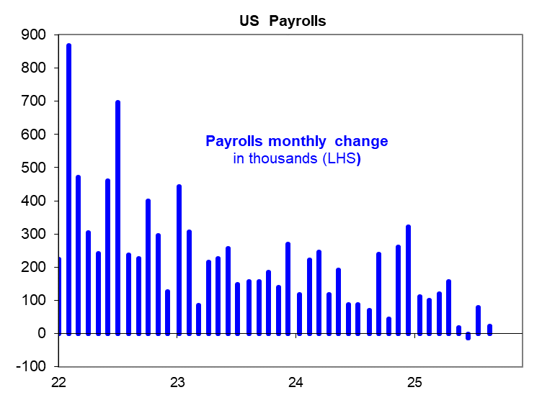
US Payrolls show a sharp slowdown in job creation and the unemployment rate rising to 4.3% There is considerable pressure on the US central bank to cut interest rates to mitigate ‘downside risks’
Federal Reserve Chair comments on August 22nd show concern about the
“ risks to employment to the downside” :
“ Putting the pieces together, what are the implications for monetary policy? In the near term, risks to inflation are tilted to the upside, and risks to employment to the downside—a challenging situation. When our goals are in tension like this, our framework calls for us to balance both sides of our dual mandate. Our policy rate is now 100 basis points closer to neutral than it was a year ago, and the stability of the unemployment rate and other labor market measures allows us to proceed carefully as we consider changes to our policy stance. Nonetheless, with policy in restrictive territory, the baseline outlook and the shifting balance of risks may warrant adjusting our policy stance.
Slowdown in US job
creation
AAAequityCYCLE.xls

Slide 14
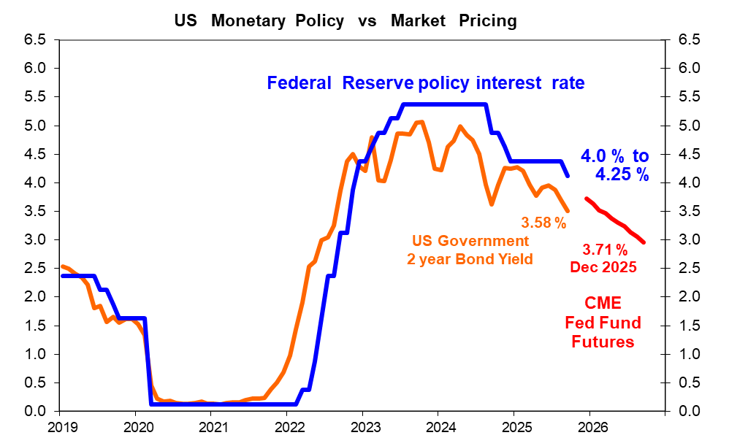
America’s central bank lowered the cash interest rate by 0.25 % in September after cutting interest rates by 1% last year. Financial markets are now pricing in a further reduction in the FED’s policy interest rate by the end of 2025.

Slide 15
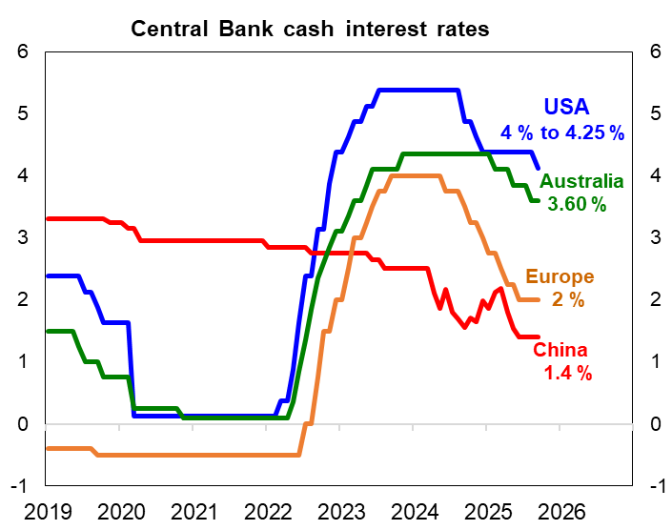
Australia’s Reserve (RBA) has been the most cautious central bank since the start of 2024 with 0.75% in interest rate cuts. By comparison, major central banks have cut by +1%
Central Bank interest rate since start of 2024
USA - 1.25 %
Australia - 0.75 %
Europe - 2.0 %
China - 1 %

Slide 16
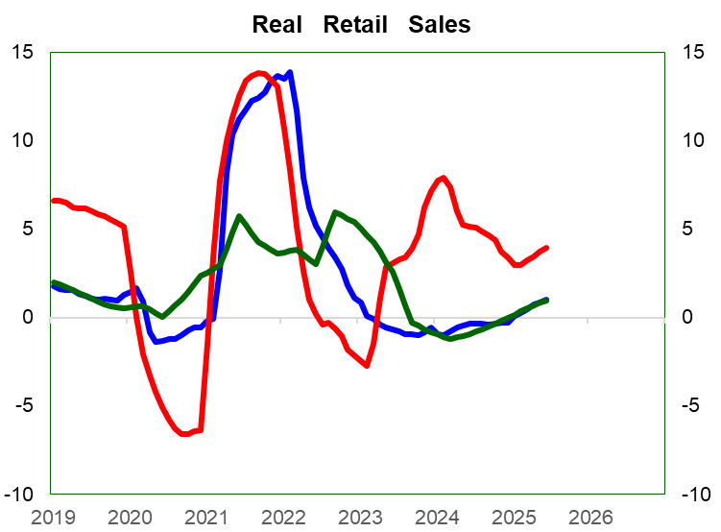
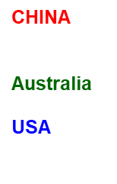
Australian and American consumer spending has slowed in the past three years given the ‘cost of living’ squeeze with high inflation and interest rates.
INFLATION
CRISIS
2021-22
Spending slowdown
Nominal retail spending adjusted for consumer inflation using year average
change measures
Source
Australian Bureau of Statistics, Federal Reserve St Louis , China NBS and Datastream
VIRUS
CRISIS
2020

Slide 17
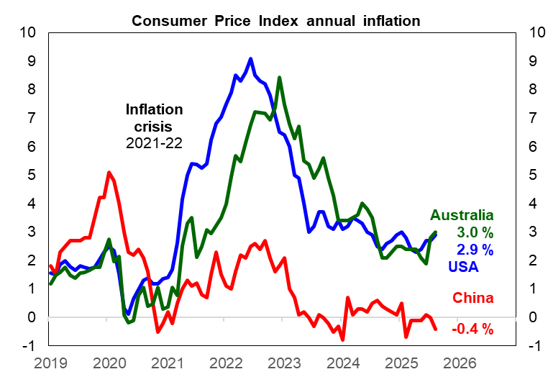
Inflation had fallen in 2023-24 in response to the spending slowdown and improved supply chains. However, American & Australian inflation is starting to grind sideways.
Source
Australian Bureau of Statistics,
Federal Reserve
St Louis , China NBS and Datastream

Slide 18
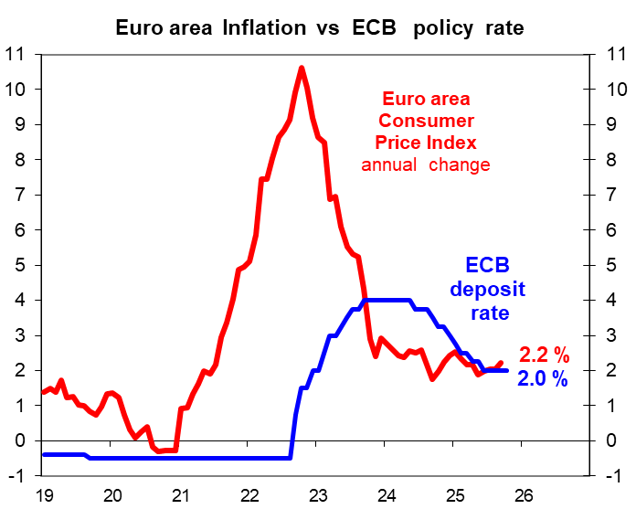
European Central Bank (ECB) had responded to milder inflation with significant interest rate reductions since mid 2024. Inflation has now become sticky around 2%
ECB President Christine Lagarde comments suggest caution about the inflation outlook :
“ The outlook for inflation remains more uncertain than usual, as a result of the still volatile global trade policy environment. A stronger euro could bring inflation down further than expected….Trade tensions could lead to greater volatility and risk aversion in financial markets, which would weigh on domestic demand and would thereby also lower inflation.
By contrast, inflation could turn out to be higher if a fragmentation of global supply chains pushed up import prices and added to capacity constraints in the domestic economy. ”

Slide 19
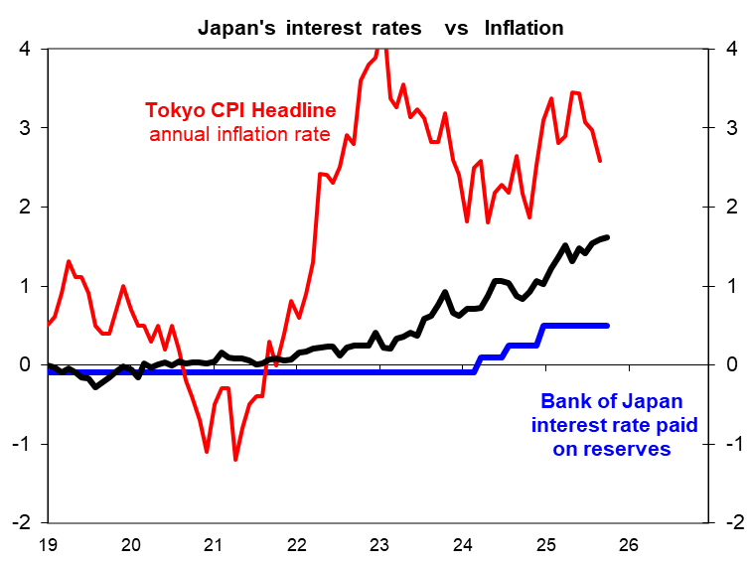
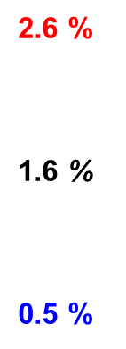
The Bank of Japan (BoJ) remains under pressure for further interest rate rises with inflation above the BoJ’s 2 % target. The BoJ last raised interest rates in January 2025.

Slide 20
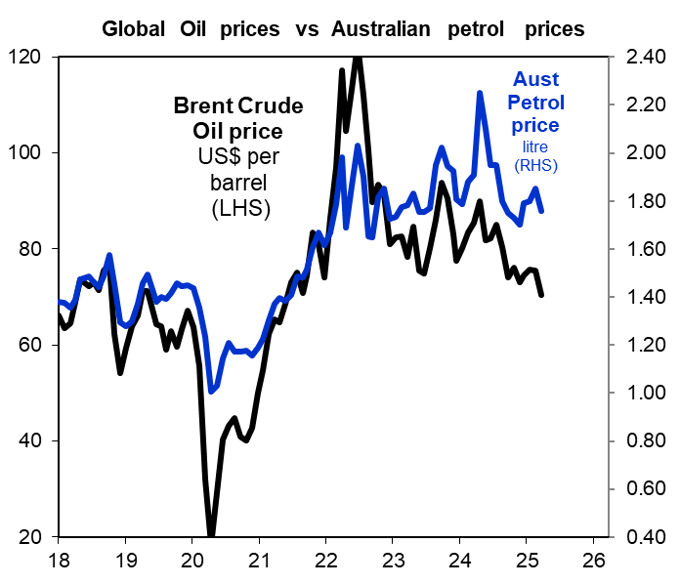




Lower global oil prices have been a positive surprise over the past two years even with conflict escalation in the Middle East & Ukraine.
A$
1.70
US$
66
Australian $ petrol price is Unleaded 91 octane
Source : FED St Louis and WA fuel Watch

Slide 21
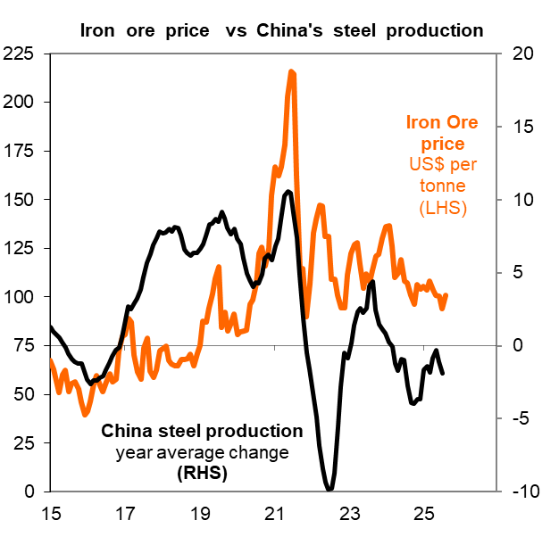
Iron Ore prices have also been a positive surprise by staying near US$ 100 per ton despite the reality that China’s steel production has peaked and is declining.
Peak China steel production at 1.1 billion tonnes in 2021
US$
104
- 1.5 %
Refinitiv / DataStream & China National Bureau of Statistics AAAequitycycle.xls

Slide 22
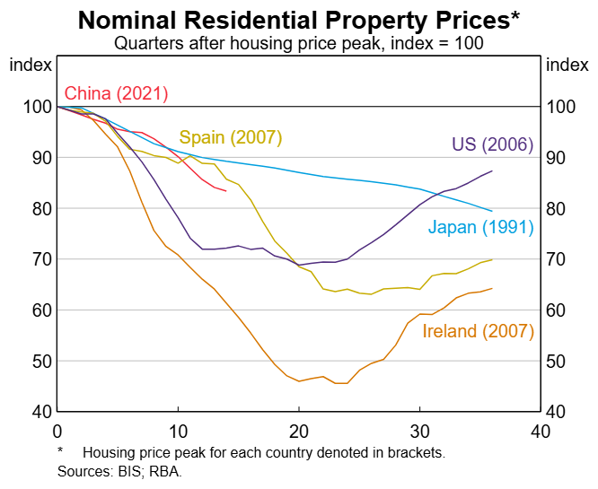
China’s residential property market remains a major concern according to the Reserve Bank (RBA).
“Conditions in the Chinese housing market remain very weak. Prices and sales of new housing (which makes up most of overall housing transactions) have declined further over recent months.
Chinese banks, and particularly rural commercial banks, maintain material direct exposures to the property sector. Risks to banks from the mortgage book are mitigated by moderate loan-to-valuation ratios.
Nevertheless, property developers remain under heavy pressure; many are imposing deeper haircuts on creditors amid a recent rise in debt restructurings, reflecting limited cash flows and deteriorating asset valuations. Household vulnerabilities also remain elevated as property prices have declined and household income growth is slowing. ”
Source : RBA Financial Stability Review , October 2025 page 5 (RBA)

Slide 23
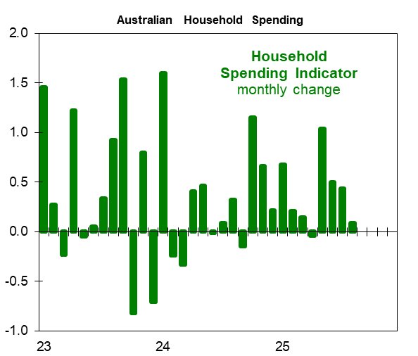
Australia’s new Nominal Household Spending Indicator for August shows a spending slowdown rather than the RBA’s view that consumer spending is “picking up” speed
RBA Board statement in September
“ In particular, private consumption is picking up as real household incomes rise and measures of financial conditions ease.
ABS media statement for August
“ Household spending rose 0.1 per cent in August,… This follows rises of 0.4 per cent in July and 0.5 per cent in June.
ABS note on Household spending indicator :
“ The indicator is produced using aggregated and de-identified card transactions from banks, supermarket scanner data, and motor vehicle sales data from the Federal Chamber of Automotive Industries and Electric Vehicle Council “

Slide 24
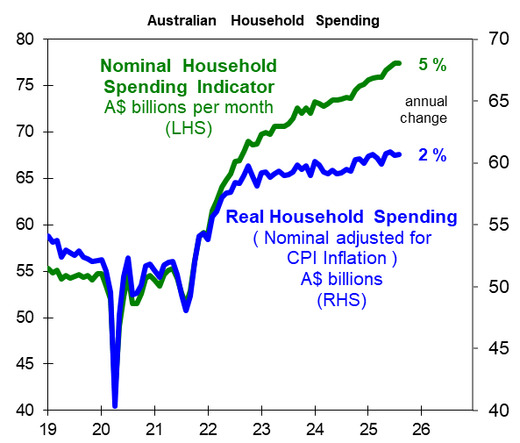
Australia’s nominal household spending for August shows annual growth at 5 %. However, after adjusting for annual consumer inflation at 3 %, real household spending is more modest at only 2 % annual growth

Slide 25
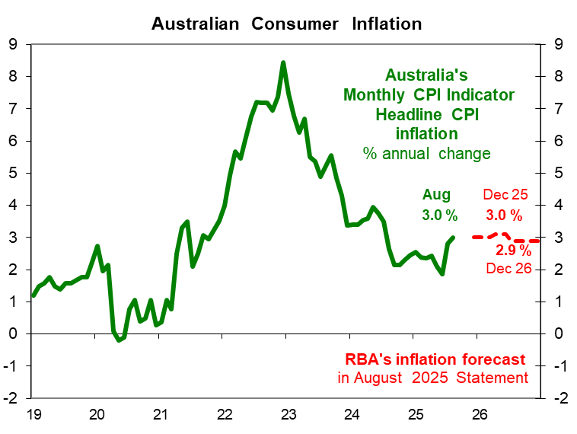
Australia’s monthly Consumer Price Index shows annual inflation picked up to 3 % in August. For the Reserve Bank, this inflation rise had been anticipated in August forecasts, so this is not alarming.
RBA’s August statement
“ Headline inflation is expected to increase over the second half of 2025, mostly due to the scheduled unwinding of electricity rebates, before returning to around the (2.5 %) midpoint of the target later in the forecast period. “
The RBA’s assessment after August CPI release showing annual inflation at 3% is that : :
“ while partial and volatile, (this) suggest that inflation in the September quarter may be higher than expected ” .
RBA Monetary Policy Board statement , September 30th
1.9 %
June

Slide 26
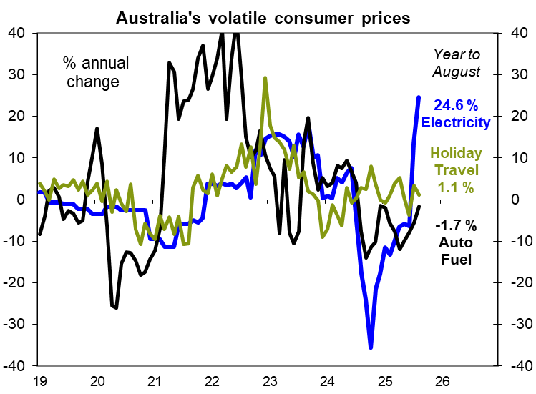
Inflation forecasting is a “difficult business ” given the volatility of components.
RBA Marion Kohler
Head of Economic Analysis Department , Sept 2023 :
“ I would make the bold claim that I think forecasting is a difficult business for all the central banks. No one saw the recent inflation surge. At least, if you go back, certainly no central bank called it out either and that is not a surprise.”
A simple illustration is the sharp swings in some Australian consumer price measures :
2020 - 2025 | CPI Index weight | Highest % chg | Lowest % chg
Auto Fuel | 3.3% | 43.2 | -26.1
Electricity | 1.8% | 24.6 | -35.6
Holiday Travel | 6.3% | 29.3 | -10.7

Slide 27
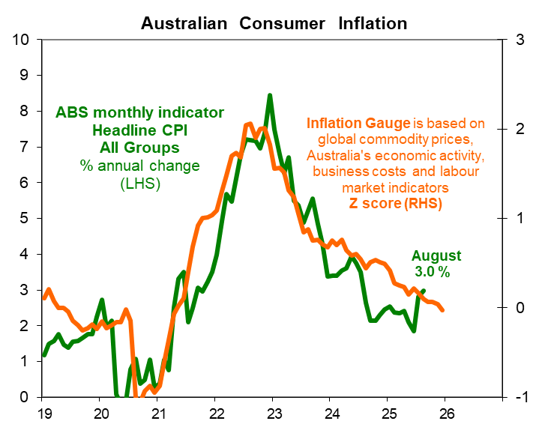

There is no rigorous economic or statistical model that accurately forecasts inflation. We are all guessing what will be the future path of consumer prices in a contingent world.
Former FED Chair Ben Bernanke :
“ Modern economies are complex and ever-changing, and they are subject to unpredictable shocks, including non-economic shocks such as pandemics or wars.
Even the current state of the economy is difficult to observe (‘nowcasting’ the economy is a specialised skill) as most economic data are available only with a lag and provide at best a rough, statistically noisy, and often subject to revision snapshot of current economic developments.”
Bank of England review , April 2024

Slide 28
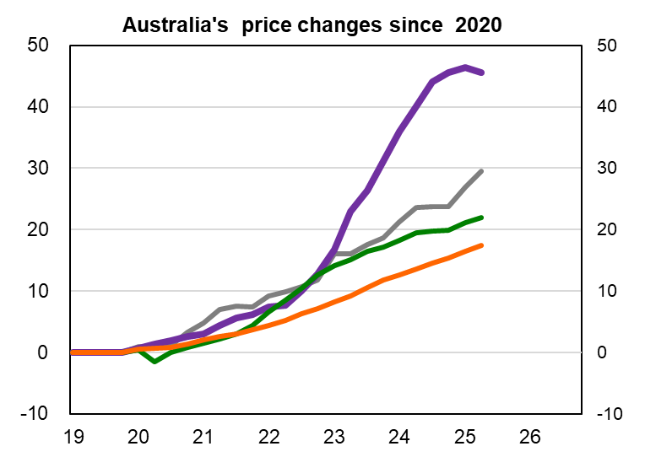
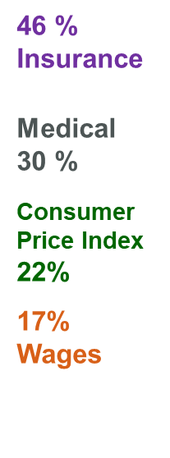
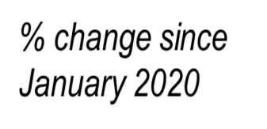

Consumer are still struggling with the “ Cost of Living ”
CPI data
is to
June 2025
Source
Australian Bureau of Statistics CPI and Wage Price Index
June 2025

Slide 29
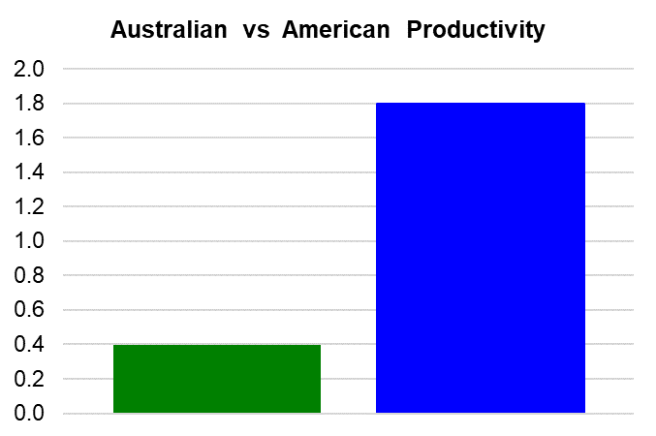
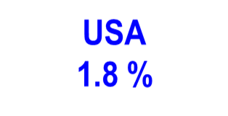
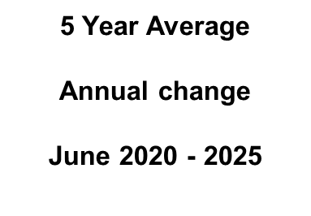
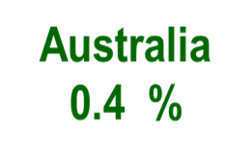
Australia’s Productivity problem. RBA is lowering their productivity growth assumption from 1 % to 0.7 % over the medium term given :
“ Productivity growth has slowed in Australia over recent decades, as it has in many advanced economies.
There is evidence to suggest that this reflects persistent factors, including declining business dynamism and competition, slower technological diffusion in the economy and lower growth in the amount of capital per worker. ”
RBA Statement of Monetary Policy
August 2025 , page 60
Australia : GDP per hour worked
USA : Non -Farm Business sector Labour Productivity Source
Australian Bureau of Statistics and FED St Louis

Slide 30
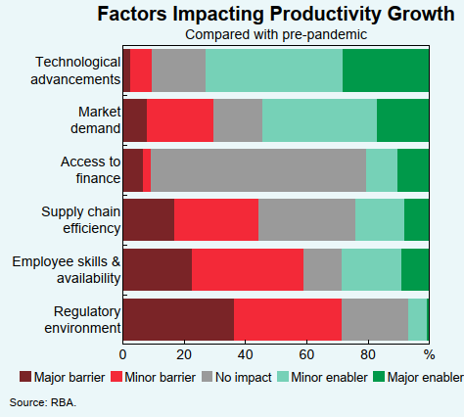
RBA has highlighted that Productivity is constrained by regulations and skills availability
“ Contacts have reported in a survey on productivity that regulation and labour availability were key barriers to lifting their productivity growth over the past five years.
Firms said that the complexity, cumulative volume and frequency of change in regulation has been hard to manage, particularly for smaller firms.
The large share of firms identifying employee skills and availability as a barrier over the recent period cited the significant turnover in the labour market, much higher wage expectations and the inability to attract specific skills when needed as factors weighing on productivity.”
RBA SMP Aug 25 , page 45

Slide 31
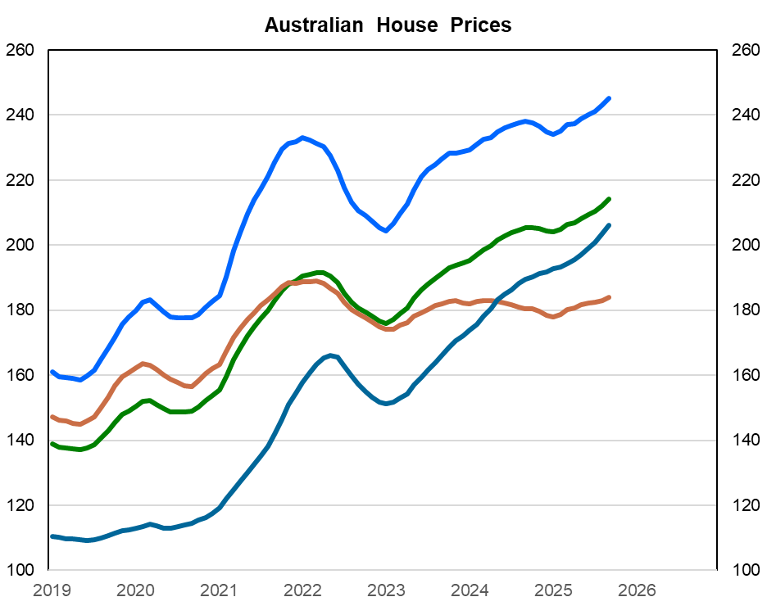


Australia’s house prices have made strong gains given the shortage of new supply. This may caution the Reserve Bank against aggressively cutting cash interest rates.
House price gains since start of 2020 to September 2025
BRISBANE 83 %
NATIONAL 44 %
SYDNEY 38 %
Melbourne 14 %

Slide 32
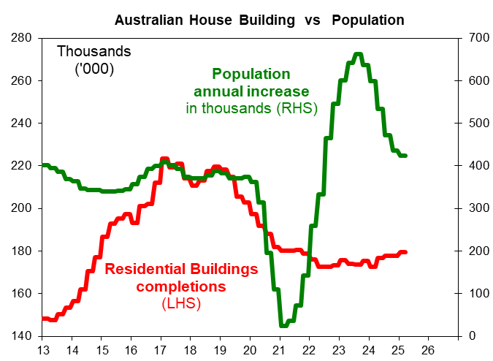
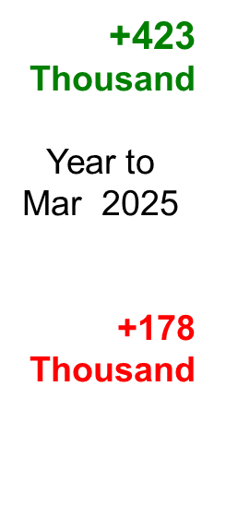

Australia’s new housing construction has been subdued despite a sharp increase in population in the past three years.
Housing shortage with population increases exceeding new housing construction

Slide 33
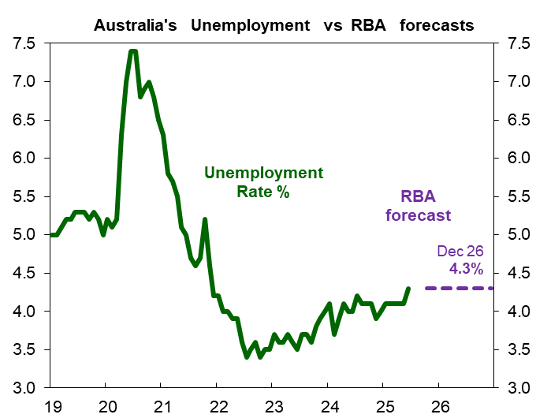

Australia’s slow economic growth over recent years has seen the unemployment rate drift higher to 4.2%. By contrast, the Reserve Bank views the labour market as still “ tight ” .
RBA’s view is the jobs market as still “ tight ”:
“The unemployment rates held steady at 4.2 percent, so it has eased over the past year and we think that the - if you look at some of the forward-looking indicators like vacancies, if you look at surveys, you look at our liaison, all of those things don’t suggest that there is mass lay-offs coming or anything like that…. Overall, we assess that some tightness in labour market conditions remains, though there is considerable uncertainty around this assessment. “”
Source : RBA Michelle Bullock , September 30
4.2 %
July 22
3.4 %
AustLabour.xls

Slide 34
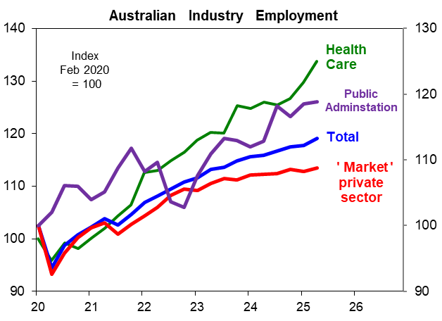
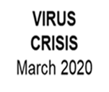
Australia’s recent strong jobs growth is concentrated in industry sectors that are reliant on government spending. By contrast, the private ‘market ‘ sector is seeing only mild jobs growth.
Health care which is the largest jobs sector (now 2.4 million) has seen +603,000 extra jobs since February 2020.
Public Administration at 157,000 thousand and Education at 147 thousand has also seen large increases.
Essentially these three sectors of Health, Education and Public Administration account for 53% of the employment created since February 2020.
The private “market” sector only accounts for the remaining 47% of jobs including sectors such as construction, finance and retail.
Source: RBA, ABS

Slide 35
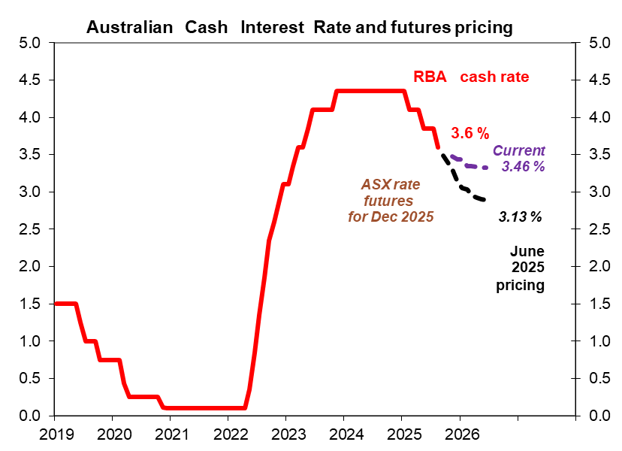

Australia’s Inflation pickup has seen market expectations shift on future interest rates. Prospects for another 0.25% RBA interest rate cut this year appear to have faded.
RBA Governor Michele Bullock commenting on the market pricing of future interest rates :
“ I’m not going to say they’re right or wrong, because as I’ve said earlier, it will depend a little bit on what we see coming over the next few months and what our forecasts end up being …..
“And as you’ve seen, actually they adjust depending on what the data come in.
So six weeks ago, they did expect more cuts.
Now they don’t because of the inflation data, so I wouldn’t say they’re right or wrong.
I do take notice of what they’re what they’re predicting, but I’m not basing my own thoughts. “

Slide 36
APPENDIX
36

Slide 37

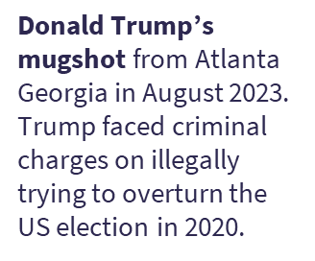
The key “Geo-political Risk”

Slide 38
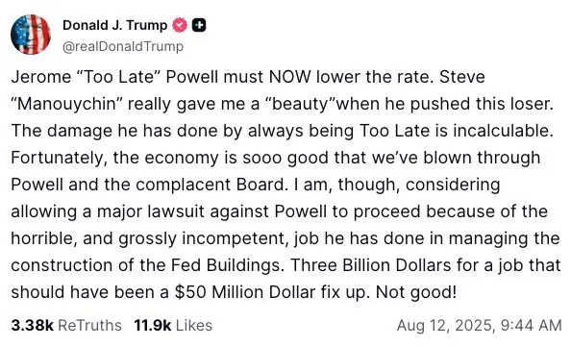
President Trump’s diplomatic skills with Federal Reserve Chair Jerome Powell
President Trump
nominated Powell to be the FED Chair in 2018 and Republicans in Congress approved
Powell’s
appointment.
Ex Treasury
Secretary
Steve
Mnuchin

Slide 39

Long term government bond yields have been rising steadily. This suggests investors are concerned over budget deficits and debt obligations as well as persistent inflation.

Slide 40

China’s industrial production still shows solid growth but consumers are reluctant to spend judging by the soft retail spending data.
The adverse impact of President Trump’s increased tariffs on Chinese exports and production is yet to appear.
China’s production data has been solid given that US importers made increased orders to beat the tariffs.
Negotiations between the White House and Beijing are continuing , so the final impact of tariffs on China’s activity is ‘wait and see’ proposition.
China’s industrial production is still showing growth at 5.7 % annual change.
Retail sales are subdued with 3.7 % annual growth as the property market weakness continues to weigh.
5.7%
3.7 %
AAAequitycycle.xls

Slide 41

RBA economic forecasts in August’s statement

Slide 42

Australian Dollar is struggling versus the US Dollar given our bond yields and interest rates are below the United States.
^{Source : RBA and Datastream}

Slide 43




Australia’s economy has improved with Real GDP growth at 1.8 % in the year to June. The leading indicators suggest that economic activity is still modest and requires further interest rate stimulus to get back to potential growth at circa 2.5 %
Leading indicators are a composite of business & consumer surveys, car sales, commodity prices and housing approvals

Slide 44
Moody’s downgraded the US government credit rating from AAA to Aa1 with a negative outlook in May 2025 with the following rationale :
“ Successive US administrations and Congress have failed to agree on measures to reverse the trend of large annual fiscal deficits and growing interest costs. We do not believe that material multi-year reductions in mandatory spending and deficits will result from current fiscal proposals under consideration.
Over the next decade, we expect larger deficits as entitlement spending rises while government revenue remains broadly flat. In turn, persistent, large fiscal deficits will drive the government's debt and interest burden higher. The US' fiscal performance is likely to deteriorate relative to its own past and compared to other highly-rated sovereigns.
As a result, we expect federal deficits to widen, reaching nearly 9% of GDP by 2035, up from 6.4% in 2024, driven mainly by increased interest payments on debt, rising entitlement spending, and relatively low revenue generation. We anticipate that the federal debt burden will rise to about 134% of GDP by 2035, compared to 98% in 2024.”
https://ratings.moodys.com/ratings-news/443154

Slide 45





USA has been running large budget deficits since Clinton’s last year in the White House in 2020 Moody’s forecast is just another warning over the lack of fiscal discipline.
Clinton
2000
Moody’s forecast “reaching nearly 9% of GDP by 2035, up from 6.4% in 2024 ”
BIDEN
21-25
- 9 % in 2035
TRUMP
2017-21

Slide 46
President Trump and the Republican Party’s “One Big Beautiful Bill ” passed in July 2025 aims to lower taxes, cut welfare support and increase spending on ‘security’. ‘
Extend the 2017 Personal Income Tax Cuts that were due to expire at end of 2025.
No taxes on tips & overtime for service workers up to $25,000 in income.
Child tax credit sees a $ 200 increase to $2,200 until 2028.
Tax deductions on up to $10,000 in interest paid on car loans for cars made in USA.
but ending of tax incentives for buying new Electric Vehicles ‘ EVs ’ of US$ 7,500.
1 % tax for foreign cash payments sent by non-U.S. citizens.
Medicaid work requirements & eligibility checks as well as restrictions on access to food stamps programs (SNAP cut by $ 128 billion ).
Border security : $ 100 billion extra funding to Immigration and Customs Enforcement (ICE) to reduce illegal immigration.
Extra Defence spending of $ 150 billion.
Sources : YALE Budget Lab , https://www.cbsnews.com/news/whats-in-trumps-one-big-beautiful-bill-medicaid-taxes/

Slide 47

US budget analysis typically focuses on the “Total Debt held by the Public” which is “Gross Government Debt less the intragovernmental holdings”
121 %
96 %
Debt held by the Public excludes “intra government holdings” which is debt is held by “Social Security, Medicare, and other federal programs “” that “purchase Treasury debt for their trust funds.” according to the US Treasury
Understanding the National Debt | U.S. Treasury Fiscal Data

Slide 48



Given the “ big beautiful bill ” CBO estimates that the US public debt will accelerate higher from their prior estimate of 117% to 125 % in 2034 .
2034 projection
125 %
117 %
CBO
June 2025
Biden
2021-25
96 %
https://www.cbo.gov/system/files/2025-06/61459-Debt-Service.pdf

Slide 49


US Congressional Budget Office ( CBO ) latest estimates for the “ One Big Beautiful Bill ” recently passed by the US House of Representatives. The net impact is an additional US 3 trillion in Debt …
https://www.cbo.gov/system/files/2025-06/61459-Debt-Service.pdf

Slide 50
Potential impact of President Trump’s tariffs on the US economy according to Yale University is a rise in inflation, slower economic growth and less jobs.
American consumers confront an “average effective tariff rate of 20.6%, the highest since 1910.”
Inflation : The “price level from all 2025 tariffs rises by 2.1% in the short-run, the equivalent of an average per household income loss of $2,800 in 2025 “
Economic activity : “ US real GDP growth over 2025 is -0.9 percent lower from all 2025 tariffs.
In the long-run, the US economy is persistently -0.5% smaller “
Labor Market : “ The unemployment rate rises 0.5 percentage point by the end of 2025, and payroll employment is 641,000 lower.
Long-Run “ . US manufacturing output expands by 2.6%, but these gains are more than crowded out by other sectors: construction output contracts by 4.1% and agriculture declines by 0.8%.
Fiscal Effects: All tariffs to date in 2025 raise $3.0 trillion over 2026-35, with $487 billion in negative dynamic revenue effects, bringing dynamic revenues to $2.5 trillion.
Yale University Budget Lab : https://budgetlab.yale.edu/research/state-us-tariffs-july-14-2025

Slide 51
Can the USA have a “fiscal crisis” ? There are many paths to a fiscal crisis but ultimately the destination is devastating.
A fiscal crisis is “ a sudden, large, and persistent downturn in demand for Treasury securities relative to supply that triggers a sharp and persistent spike in interest rates. Such a rise in interest rates on Treasuries would most likely precipitate a crisis in “the global financial system” .
Brookings suggested four possible scenarios involving inflation risks, political brinkmanship , FED changing their inflation target and finally the deterioration in “long term fiscal outlook”
Demand or supply of Treasuries could abruptly shift for reasons unrelated to inflation or default risk such that interest rates spike, causing financial market disruptions that the Federal Reserve is unable or unwilling to mitigate.
Investors could come to believe that the U.S. Treasury might default on interest or principal payments because of political brinkmanship, and policymakers would be unable or unwilling to regain credibility.
The Federal Reserve could be perceived as abandoning its mandate to preserve price stability and instead allowing for hyperinflation.
The long-term fiscal outlook could deteriorate so significantly and so sharply that investors abruptly worry about some form of default, leading them to abandon Treasuries until policymakers take actions to rein in deficits.
https://www.brookings.edu/articles/assessing-the-risks-and-costs-of-the-rising-us-federal-debt
/

Slide 52

US Government term premiums have risen sharply over recent years to compensate for perceived credit and duration risk ( essentially higher risk premiums )
Term premium is
“compensation that investors require for bearing the risk that interest rates may change over the life of the bond.
Since the term premium is not directly observable, it must be estimated, most often from financial and macroeconomic variables. ”
FED NY
https://www.newyorkfed.org/research/data_indicators/term-premia-tabs#/overview
Dot.Com
GFC
Pandemic
September
0.52 %

Slide 53
Impact of Republican budget proposals on US households
“ CBO estimates that household resources would decrease by an amount equal to about 2 percent of income in the lowest decile (tenth) of the income distribution in 2027 and 4 percent in 2033, mainly as a result of losses of in-kind transfers, such as Medicaid and SNAP
By contrast, resources would increase by an amount equal to 4 percent for households in the highest decile in 2027 and 2 percent in 2033, mainly because of reductions in they taxes they owe. The distributional effects vary throughout the 10-year projection period as different components of the legislation are phased in and out. ”
https://www.cbo.gov/system/files/2025-05/61422-Reconciliation-Distributional-Analysis.pdf

Slide 54

Compared to USA, Australia shows more fiscal discipline with lower government debt
US Gross Debt could climb to +140% of GDP in 2025 according to the Congressional Budget Office analysis of the Republican Party’s One Big Beautiful Bill passed in July
121 %
49 %

Slide 55














Financial conditions yet to show significant tightening according to the FED Chicago NFCI
NFCI is a weighted average of a large number of variables (105 measures of financial activity)
Since March 2023
financial conditions have become easier
- 0.56
Sept 2025

Slide 56

Global Economy depends on the Middle East for oil supply. Yet the USA is self sufficient
Top 10 Oil producers in 2023 * includes crude oil, all other petroleum liquids, biofuels and refinery
Country | Million barrels per day | Share of world total
United States | 21.9 | 22 %
Saudi Arabia | 11.1 | 11 %
RUSSIA | 10.8 | 11 %
Canada | 5.8 | 6 %
China | 5.3 | 5 %
Iraq | 4.4 | 4 %
Brazil | 4.3 | 4 %
UAE | 4.2 | 4 %
IRAN | 4.0 | 4 %
Kuwait | 2.9 | 3 %
Total top 10 | 74.6 | 73 %
World total | 101.8
Sources: US Energy Information Agency https://www.eia.gov/tools/faqs/faq.php?id=709&t=6

Slide 57

Russia – Ukraine War appears to be a stalemate with Russia holding eastern Ukraine & Crimea despite Ukraine’s brave defence
UKRAINE has a smaller defence force than Russia yet has still managed to inflict more casualties.
 | RUSSIA | UKRAINE
Active Soldiers | 1.32 million | 0.9 million
Fighter aircraft | 809 | 72
Tower Artillery | 8,356 | 1,012
Casualties Killed, Wounded & Missing | + 200 thousand | + 130 thousand
Source ; Statista & Harvard University Kennedy School Belfer Centre

Slide 58

A China – Taiwan War would have parallels to Russia – Ukraine in terms of a large attacker against a small nation. The question is - Does the United States then defend Taiwan ?
BBC analysis :
“ President Xi Jinping has said "reunification" with the island must be fulfilled and is believed to have a deadline. In a military confrontation, China's armed forces would dwarf those of Taiwan.”
 | CHINA | TAIWAN
Active Soldiers | 2 million | 169 thousand
Fighter aircraft | 3,438 | 531
Tower Artillery | 9,752 | 2,093
Taiwan sits in the so-called "first island chain", which includes a list of US-friendly territories that are crucial to Washington's foreign policy in the region.
Source ; The Military Balance , ISS & BBC
https://www.bbc.com/news/world-asia-china-59900139

