Slide 1
Global Economics & Markets
Bob Cunneen
Senior Economist
July 2026

Slide 2
Important information
Important information
This communication is provided by MLC Investments Limited (ABN 30 002 641 661, AFSL 230705) (MLC), part of the Insignia Financial Group of companies (comprising Insignia Financial Ltd, ABN 49 100 103 722 and its related bodies corporate) (‘Insignia Financial Group’).
An investment with MLC does not represent a deposit or liability of, and is not guaranteed by, the Insignia Financial Group.
This information may constitute general advice. It has been prepared without taking account of an investor's objectives, financial situation or needs and because of that an investor should, before acting on the advice, consider the appropriateness of the advice having regard to their personal objectives, financial situation and needs.
Past performance is not a reliable indicator of future performance. Share market returns are all in local currency.
Any opinions expressed in this communication constitute our judgement at the time of issue and are subject to change. We believe that the information contained in this communication is correct and that any estimates, opinions, conclusions or recommendations are reasonably held or made as at the time of compilation. However, no warranty is made as to their accuracy or reliability (which may change without notice), or other information contained in this communication.
This information is directed to and prepared for Australian residents only.
MLC may use the services of any member of the Insignia Financial Group where it makes good business sense to do so and will benefit customers. Amounts paid for these services are always negotiated on an arm's length basis. MLC relies on third parties to provide certain information and is not responsible for its accuracy, nor is MLC liable for any loss arising from a person relying on information provided by third parties.
Bloomberg Finance L.P. and its affiliates (collectively, “Bloomberg”) do not approve or endorse any information included in this material and disclaim all liability for any loss or damage of any kind arising out of the use of all or any part of this material.
The funds referred to herein is not sponsored, endorsed, or promoted by MSCI, and MSCI bears no liability with respect to any such funds.

Slide 3
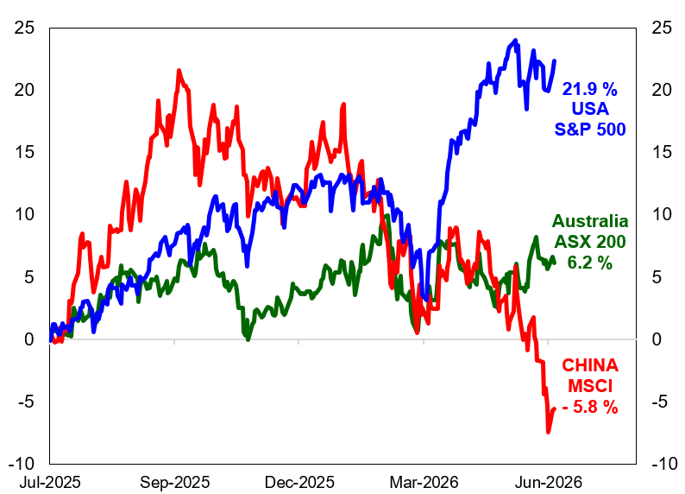
Global share markets delivered mixed performances in local currency terms for the last financial year. Optimism over Artificial Intelligence, strong corporate profits and a solid US economy favoured Wall Street. Australia’s ASX is in the slow lane.
Source
Datastream

Slide 4
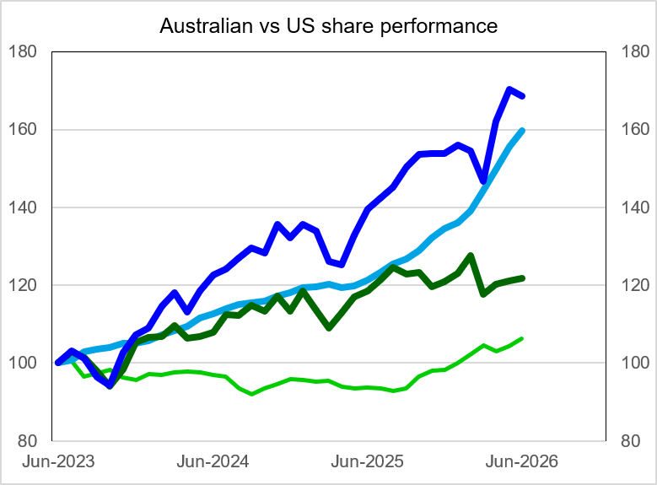
Wall Street’s return outperformance reflects stronger corporate profits growth
% gain since June 2023
S&P
68.5 %
US Profits
59.8 %
ASX
21.9 %
Australian
Profits
6.3 %
S&P 500
Return
Expected
Profits
ASX 200
Return
ASX
profits
Index to 100 June 2023
IBES Forward
Earnings estimates
Datastream

Slide 5
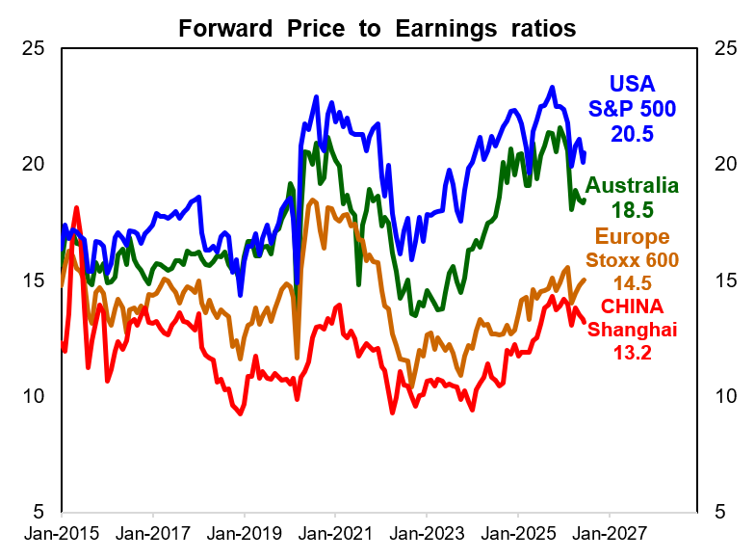
Australian and US shares have expensive valuations judging by high Forward P/E
Decade average Forward Price to Earnings
USA
S&P 500
18.3
Australia
16.5
Europe
14.1
CHINA
11.1
2015 – 2024
IBES data

Slide 6
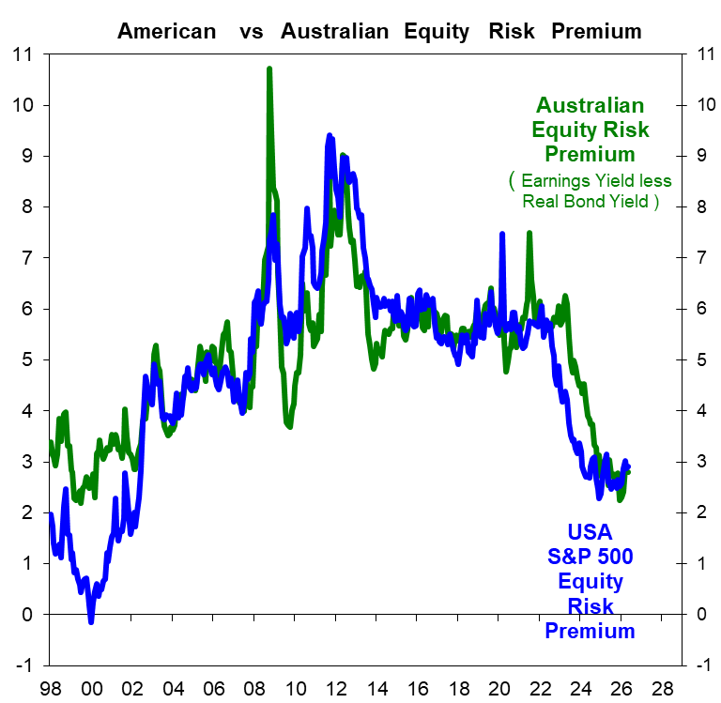
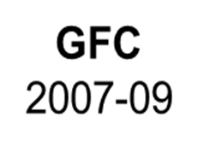
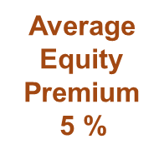
Equity risk premiums remain extraordinarily low for American & Australian Shares
Equity Risk Premium is the Forward Earnings Yield on Shares less the 10-year Real Government
Bond Yield or equivalent.
The Forward Earnings Yield is the inverted Price to Earnings ratio
Average
Equity Risk
Premium
1998 - 2024
Australia
5.1 %
USA
4.9 %
 | Forward PE | Earnings Yield | Real Bond | Equity premium
USA | 20.5 | 4.88 | 2.30 | 2.58
Aus | 18.5 | 5.41 | 2.55 | 2.96

Slide 7
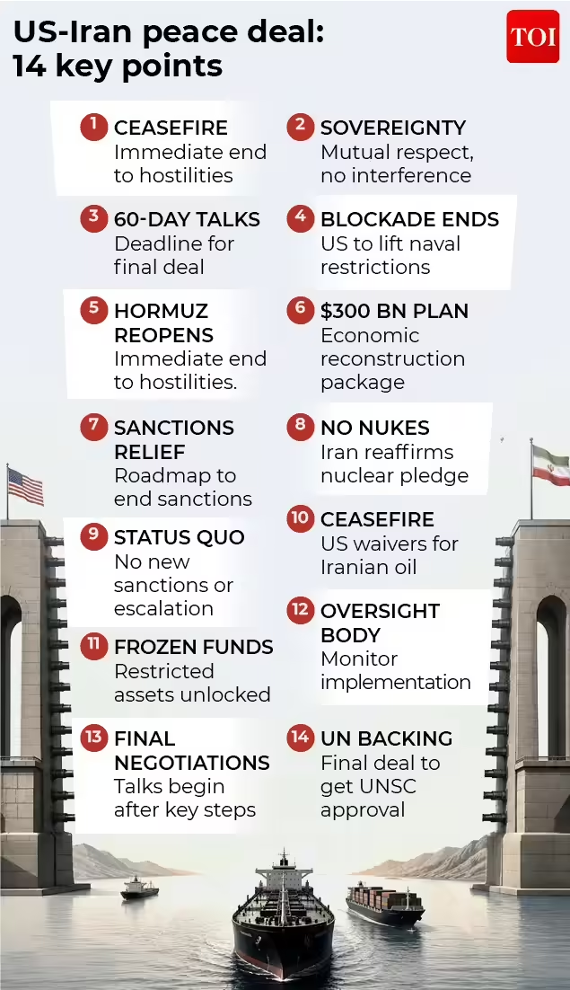
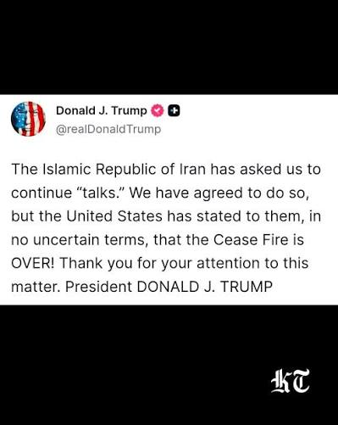
The ceasefire between Iran and the USA is over according to President Trump.
June 17, 2026
July 10, 2026
University of Chicago

Slide 8
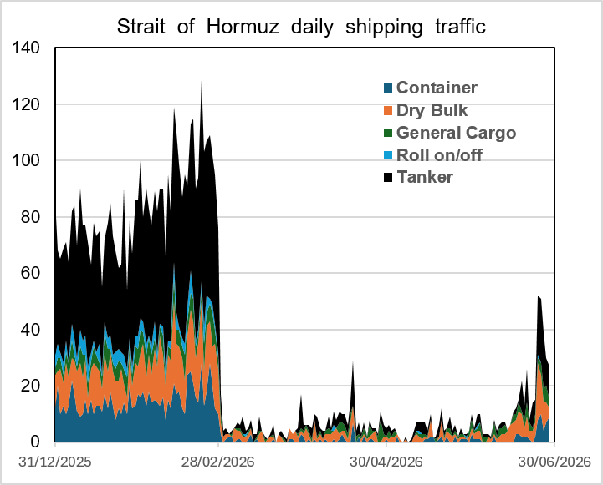
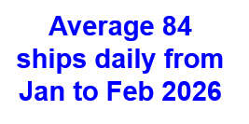

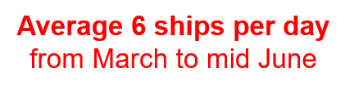
Iran appears to have again closed the Strait of Hormuz to shipping.
The recent opening only allowed 38% of the pre-war traffic flows
Source
IMF
PORTWATCH
https://portwatch.imf.org/pages/chokepoint6
Average 32 ships daily in last 7 days to July 5

Slide 9
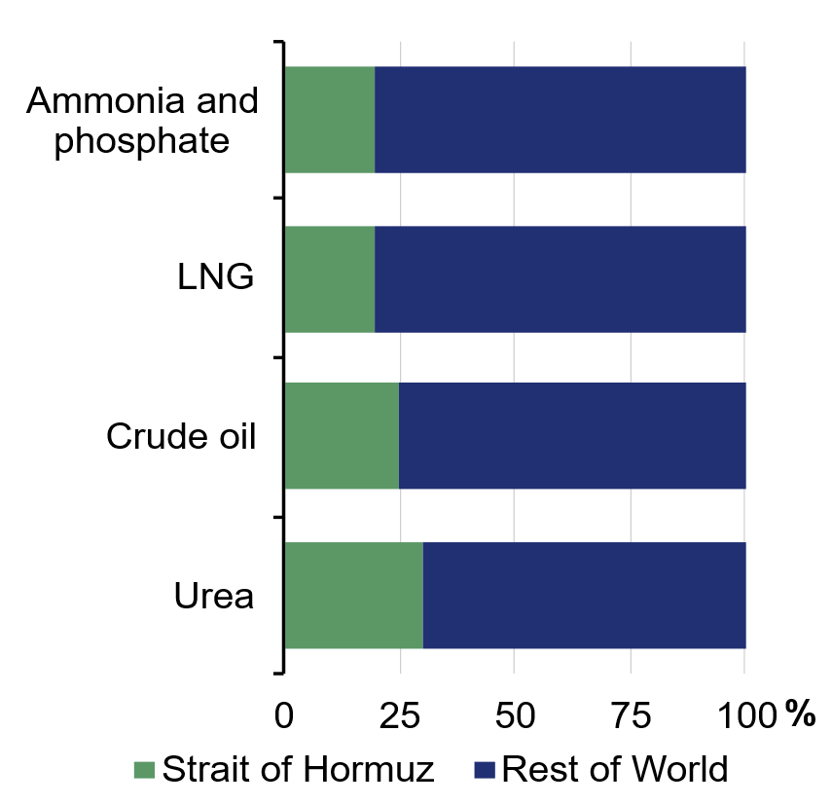
The Strait of Hormuz importance in the Global commodity supply chain.
“ The Middle East is a significant global producer of crude oil, refined petroleum products, LNG and LPG, and the Strait of Hormuz is central to global supply chains
Gulf countries account for around 8 % per cent of global aluminium production and around 10 per cent of global ethylene production
(a feedstock used to manufacture plastics and clothing).
Around one third of global seaborne fertiliser supply also transits the Strait of Hormuz, placing additional pressure on input costs for businesses in all economies. ”
Share of global commodity trade transiting the Strait of Hormuz
Australian Federal Budget Paper 1 , page 51

Slide 10
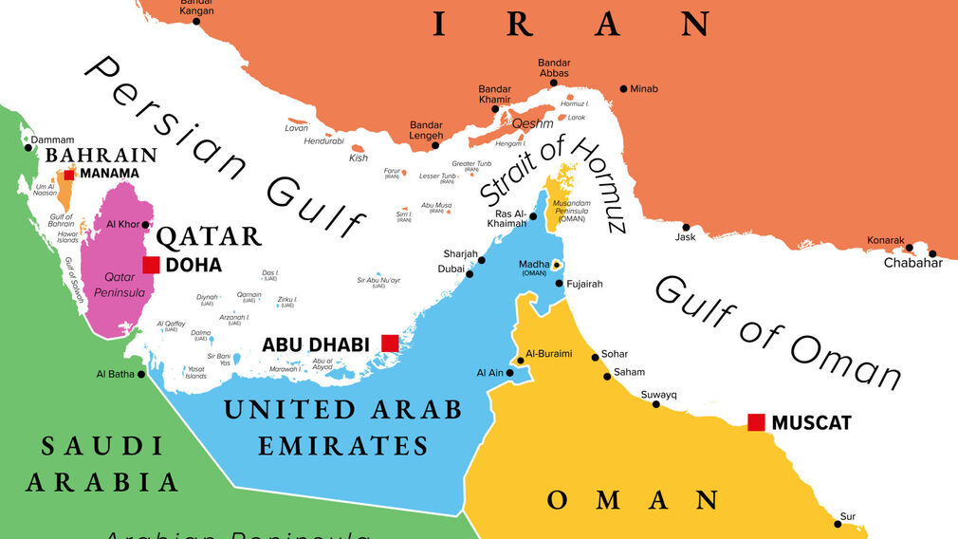
Global Economy depends on the Middle East for oil supply. Yet the USA is self sufficient
Top 10 liquid fuel producers in 2025 * includes crude oil,, biofuels and refinery production.
Country | Million barrels per day | Share of world total
United States | 23.6 | 22 %
Saudi Arabia | 11.2 | 11 %
RUSSIA | 10.8 | 10 %
Canada | 5.8 | 6 %
China | 5.3 | 5 %
IRAN | 4.7 | 4 %
Brazil | 4.7 | 4 %
UAE | 4.6 | 4 %
Iraq | 4.4 | 4 %
Kuwait | 2.8 | 3 %
Top 10 | 78.3 | 74 %
World total | 106.3
Sources: US Energy Information Agency Short-Term Energy Outlook January 2026

Slide 11
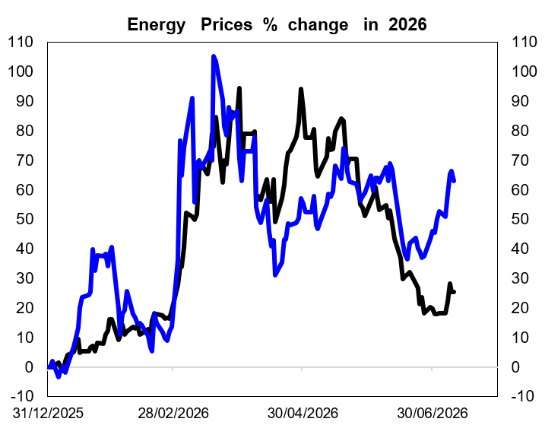
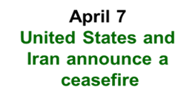


A calmer Middle East had seen global energy prices fall .
However, the ceasefire’s durability is now questionable given the recent attacks.
Given that the Gulf States are key producers of Oil
and Liquid Natural Gas
( Qatar is the worlds largest LNG producer ), the Iran War is a ‘Global Energy Shock’ .
The benchmark Brent oil peaked at US$118 per barrel at the end of March.
Currently Brent is circa US$ 76.
YTD price rise is now +25 %
Notably Europe’s LNG future prices are still up 63% ytd indicating supply concerns continue for Qatar & Russia.

Slide 12
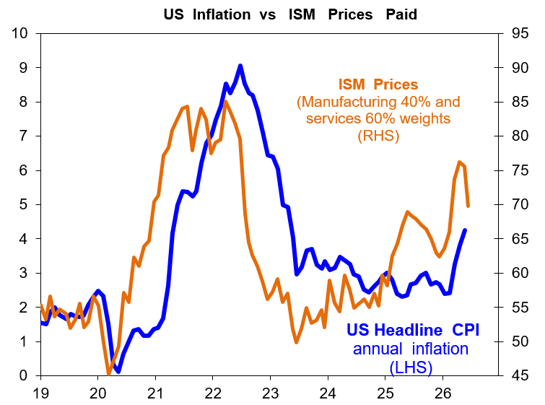
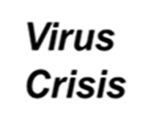
US consumer inflation data for May showed Headline annual inflation rising from 3.8 % to 4.2 % and core inflation edging up from 2.8 % to 2.9 %.
Select comments from
ISM Manufacturing survey for June
“The conflict in Iran has impacted pricing in every category of raw materials. Especially, items that have a heavy concentration of oil in the components like our adhesives.”
Chemical Products
Input costs remain elevated across key categories, driven largely by Middle East conflict impacts and ongoing tariff uncertainty.”
Food & Beverage
4.2%

Slide 13
US central bank’s recent view of “ Artificial Intelligence ‘AI’ impact
“Many participants noted that ongoing strong demand for AI infrastructure would likely sustain upward pressure on prices for technology products and electricity.
Most participants remarked that growth in economic activity that exceeded that of potential output, owing in part to strong AI business investment, could contribute to more persistent inflationary pressures.
Some participants remarked that productivity gains associated with AI adoption would eventually reduce production costs and increase aggregate supply, which should put downward pressure on inflation, though they noted this effect would likely take time to materialize. ”
Federal Reserve Open Market Committee (FOMC)
June 16-17 meeting minutes

Slide 14
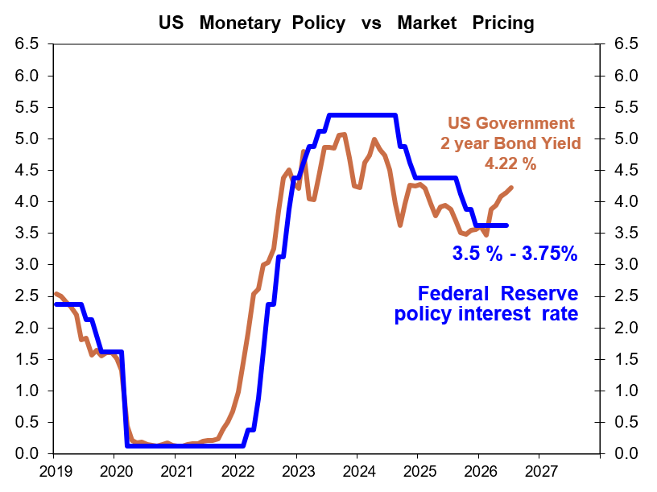
Federal Reserve’s June meeting kept the cash interest rate steady at 3.5 % to 3.75 %. Bond market is suggesting that the FED should be raising interest rates this year.

Slide 15
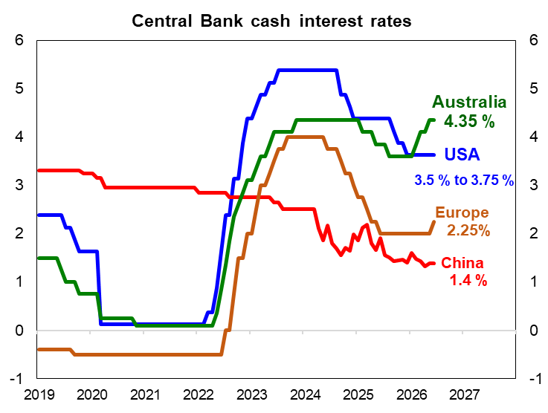
Australia’s Reserve (RBA) reversed course on interest rates with three consecutive 0.25% increases in February, March & May. The European and Japanese central banks have now joined in with interest rate rises in June. China and the USA have held rates steady
Central Bank interest rate cuts since start of 2024
Australia 0 %
USA - 1.75 %
Europe - 1.75 %
China - 1 %

Slide 16
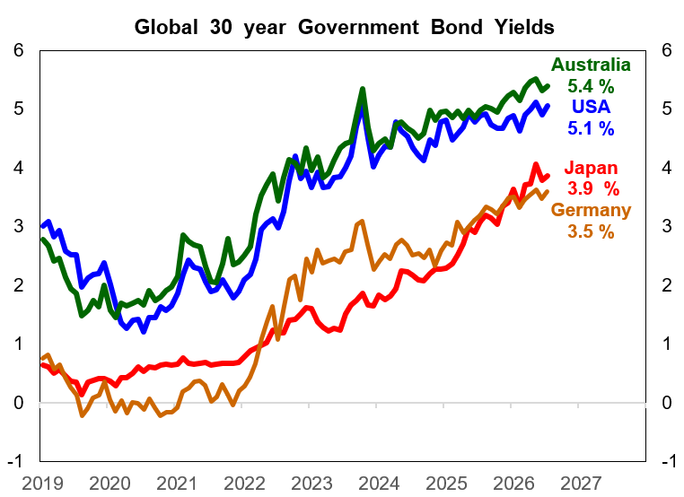
Long term government bond yields continue to rise. Investors are becoming more concerned over inflation risks with the Middle East conflict as well as rising debt obligations

Slide 17
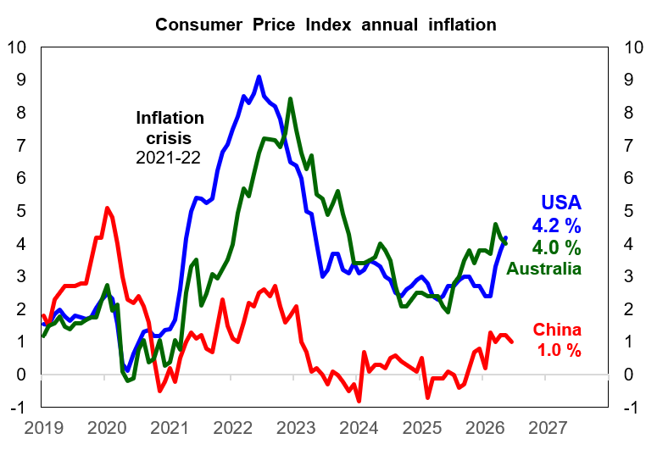
Global inflation measure have been rising with higher energy prices from the Iran War. This signals interest rate rises are being considered by central banks to contain inflation
Source
Australian Bureau of Statistics,
Federal Reserve
St Louis , China NBS and Datastream

Slide 18
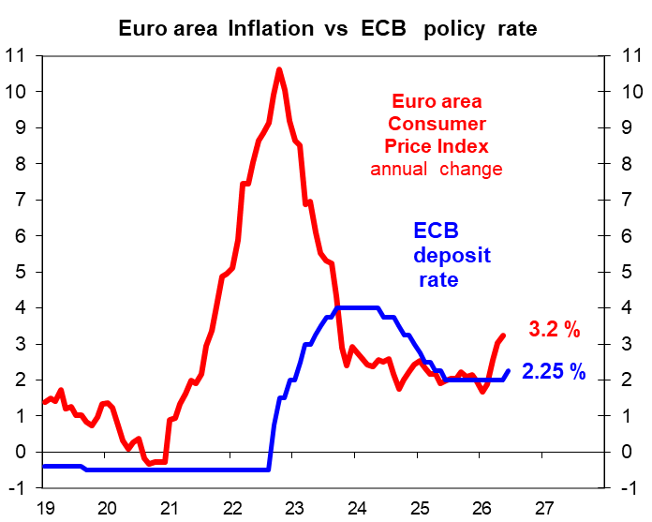
European Central Bank (ECB) raised cash interest rate by 0.25 % in June given the sharp increase in inflation with the Middle East crisis.
ECB policy statement for June:
“ …… The war in the Middle East is generating inflation pressures, and the decision to raise rates is robust across a range of scenarios mapping out how the shock might evolve and affect the medium-term outlook for the Euro area.
The outlook remains uncertain, with upside risks for inflation and downside risks for economic growth. The full implications of the war for medium-term inflation and growth will depend on the intensity and duration of the energy price shock, as well as the scale of its indirect and second-round effects.”

Slide 19
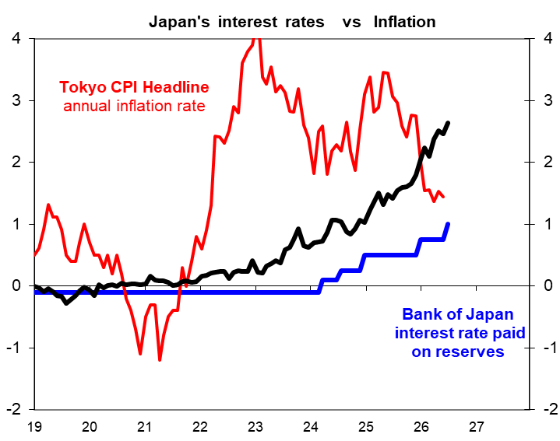
The Bank of Japan (BoJ) raised their policy interest rate by 0.25 % in June given that
“ there is a risk ” of inflation going “ above the price stability target of 2 percent ”
BoJ statement for June :
“ On the price front, the year-on-year rate of increase in the consumer price index (CPI, all items less fresh food) has recently been at a level below 2 percent due to factors such as the effects of the government's measures to reduce the household burden of higher energy prices.
However, the price pass-through stemming from the rise in crude oil prices has been progressing at a relatively fast pace in business-to-business transactions, which could spread to an increase in consumer prices across a wide range of items. ”
2.7%
JGB
10 year
1.7 %
1.0 %

Slide 20
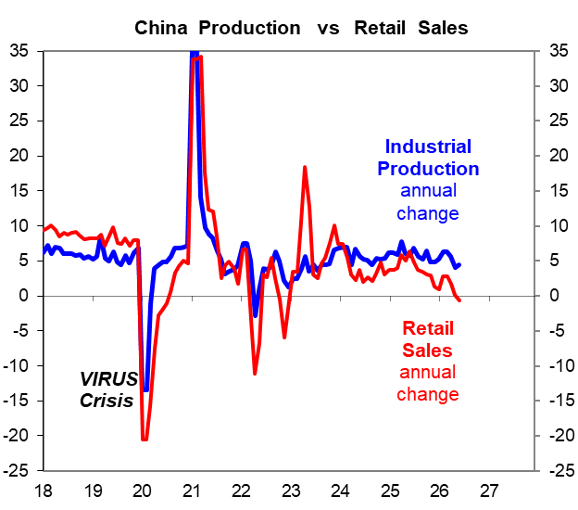
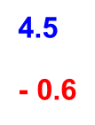
China’s activity data for May shows solid industrial production but weak retail spending given the struggling residential property market
RBA Statement May 2026 :
“ The national accounts measure of investment rebounded, with (China’s) monthly indicators suggesting this was broadly based across sectors. Notwithstanding a sharp increase in real estate investment in the quarter, growth in housing sales and prices have remained weak.
The structural imbalance between strong domestic supply and soft domestic demand has persisted, underpinned by continued weakness in household consumption growth...”
China’s industrial production is expected to grow at 4.2% annual pace in May .
Retail sales are expected to slump to a -0.5 % contraction in the year to May.
AAAequitycycle.xls

Slide 21
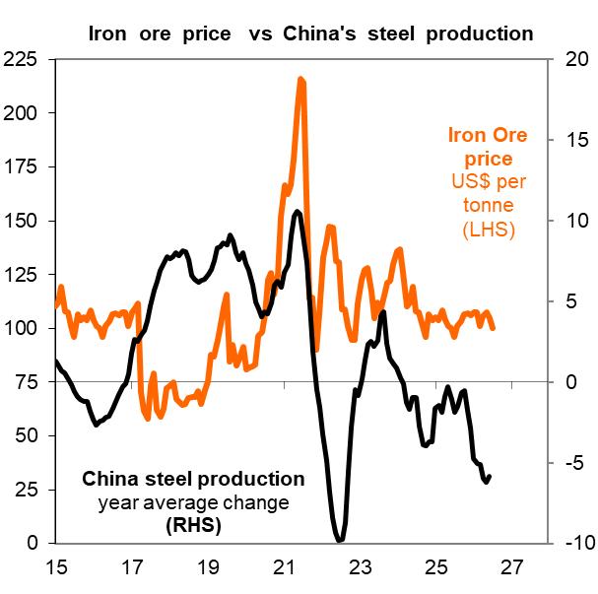
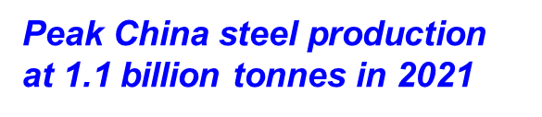
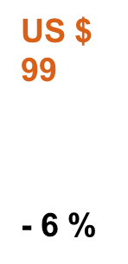
Iron Ore prices have also been a positive surprise by staying around US$ 100 per ton despite the reality that China’s steel production is falling.
Refinitiv / DataStream & China National Bureau of Statistics
AAAequitycycle

Slide 22
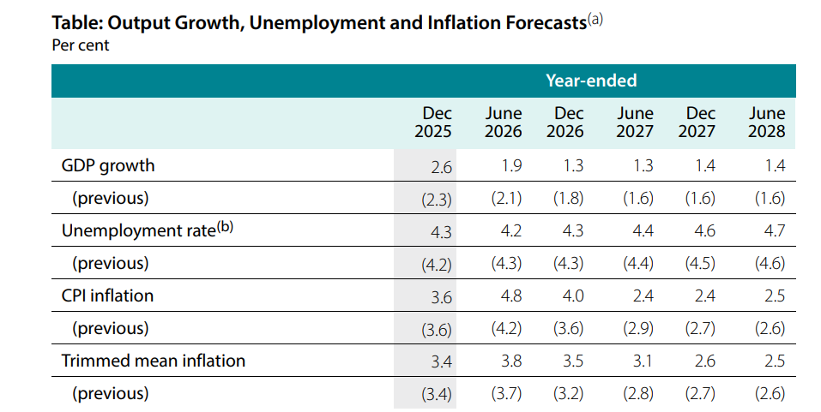
RBA’s new forecasts are for higher immediate inflation in 2026 which then moderates next year (SMP May 2026)
Forecasts profile is for :
Slower economic activity
Unemployment grinds up
Higher
INFLATION

Slide 23
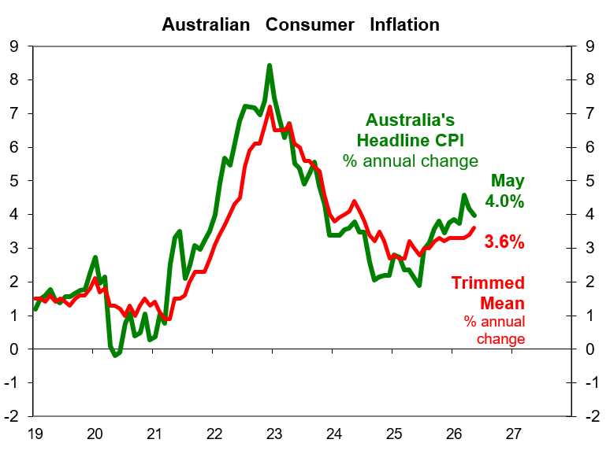
Australia’s headline annual inflation came in at 4 % and the Trimmed Mean at 3.6 % in May. This is still well above the RBA’s 2% to 3% target range .

Slide 24
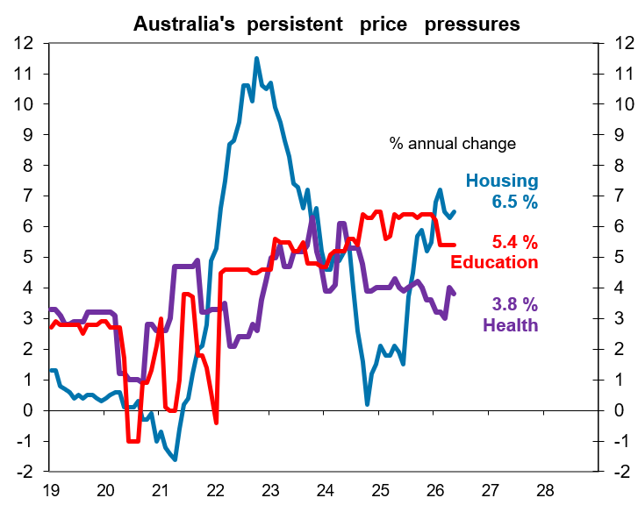
Australian key essentials still show considerable price pressures with the ABS measure showing 4.7 % annual inflation in May.
ABS measure of
Non-Discretionary CPI showed annual inflation running at 4.7%
ABS definition :
“ Goods or services which are purchased because they meet a basic need (food, shelter, healthcare), are required to maintain current living arrangements (car maintenance, school fees), or are a legal obligation (compulsory insurance, stamp duty).
Spending on these goods or services may be less responsive when there are changes in household wealth and incomes, or changes in relative prices. “
https://www.abs.gov.au/articles/measuring-non-discretionary-and-discretionary-inflation#
Hence excludes “take away meals, alcohol and holidays.”

Slide 25
RBA Board statement on June 16 :
The RBA statement again emphasised that Australia’s inflation is “ still too high” . There is some comfort with lower oil prices recently but “commodity prices remain higher than they were prior to the conflict in the Middle East. “
The RBA is still worried on the inflation risk from the Middle East conflict given that the “resolution” is only at an “early stage” with significant global oil supply disruptions.
The central bank is also concerned about immediate price pressures in the business sector and higher inflation expectations. The RBA noted that “some firms experiencing cost pressures are increasing the prices of their goods and services and others are looking to do so” . Inflation expectations “have eased but remain higher than earlier in the year”.

Slide 26
Impact of Middle East on Australian diesel fuel costs across industry sectors
“ Higher petrol and diesel prices affect both households and businesses.
Fuel prices make up around three per cent of household expenditure, with the majority of this being for petrol.
On average, liquid fuels make up less than one per cent of business costs (mostly through diesel), although the diesel share is larger for sectors like road transport (around 10 per cent), agriculture (around three per cent) and mining (around two per cent) …..
For this reason, higher fuel prices are expected to flow through to prices of other products and services”
Cost share of diesel in production
Australian Federal Budget Paper 1 , page 59

Slide 27
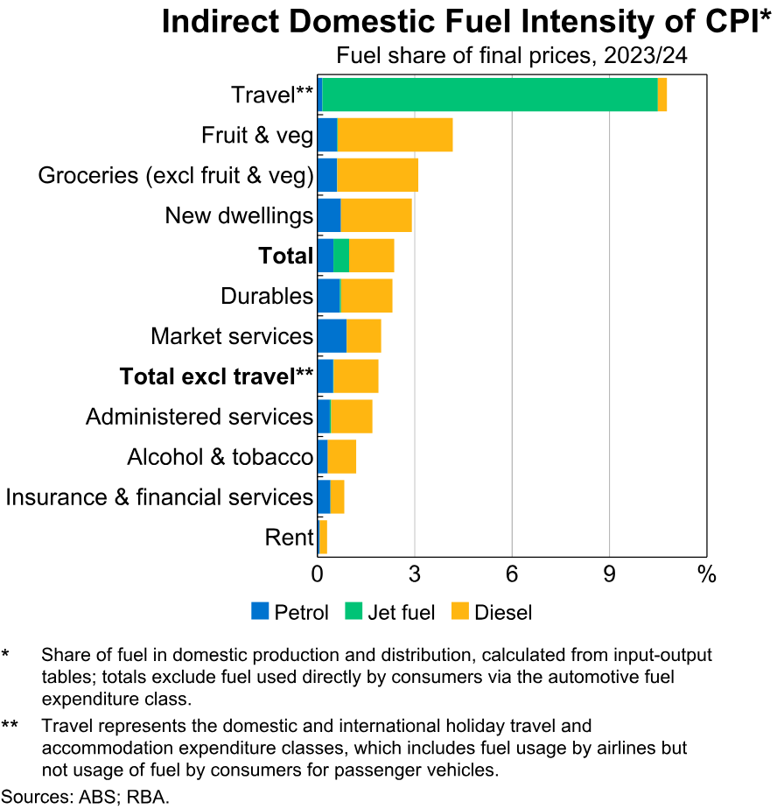
RBA notes that this Iran War “shock” is likely to lead to the “faster and more extensive “ pass-through of rising fuel prices to inflation
“…. higher fuel prices are also going to influence prices indirectly.
Domestically, fuel accounts for around
2 to 2½ per cent of the cost of producing and distributing other goods and services in the CPI
Components that are more exposed to fuel prices include travel, transport and postal services, some groceries items and new dwelling construction.
In addition, oil is also an input in global supply chains and will influence imported goods prices.
For example, oil and gas are used in the manufacture of fertilisers and plastics, and the cost of these goods has started to rise.

Slide 28
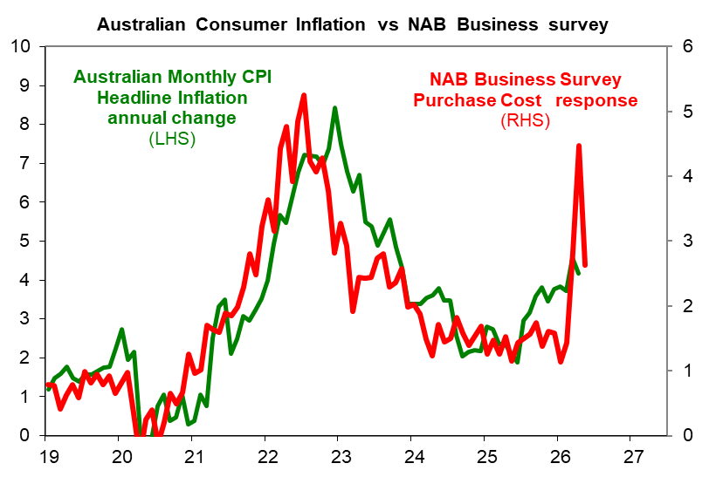
NAB survey for May shows purchases costs are moderating after April’s surge.
So the NAB has abandoned their forecast that the RBA will raise interest rate again
NAB Economics commentary :
“ Purchase cost growth fell to 2.6% in quarterly equivalent terms, but remains elevated, and labour cost growth fell marginally to 1.5%. ….
NAB abandons forecast that RBA will raise interest rates again :
“ We have been worried about a broad and rapid dissemination of inflationary pressures, but the recent slowing in momentum in the economy may short-circuit this dynamic somewhat. In summary, we have greater conviction that the next move in rates is down, but less conviction on the timing”
4.5
2.6
May
4.0%

Slide 29
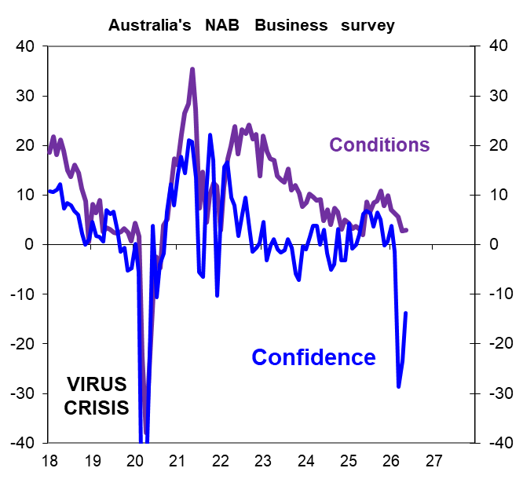
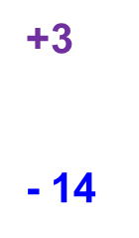
NAB survey shows that business confidence has rebounded in May but is still weak. Business conditions are sedate but below “ long run average ”
NAB Economics commentary :
• Business confidence rose 10 points ….. to -14 index points. The improvement in confidence was driven by mining, wholesale and transport & utilities (which had seen the weakest reads last month). Nonetheless, trend confidence remains negative in all industries.
• Business conditions held at 3 index points - below its long-run average “

Slide 30
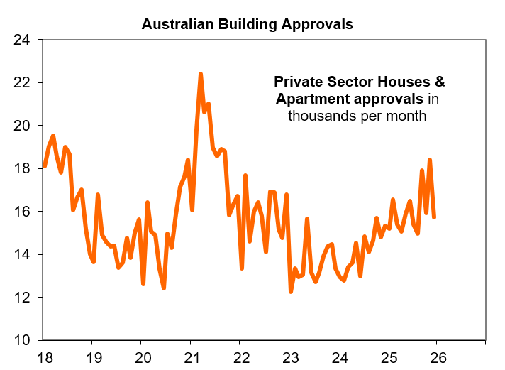
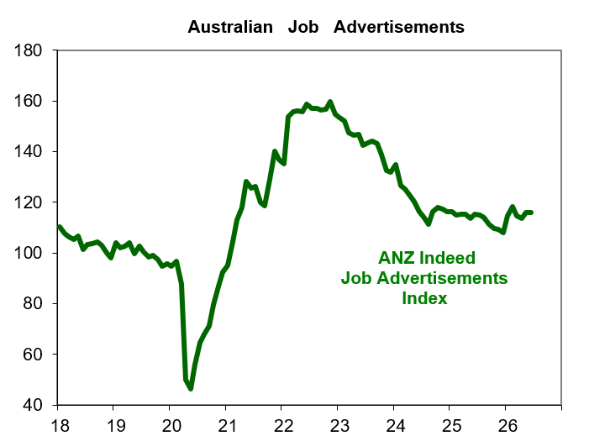

Recent Australian economic activity data is subdued with a slowdown in new house building approvals and flat job advertisements.
June
annual change
+0.4 %
+ 4.2%
May
annual change

Slide 31
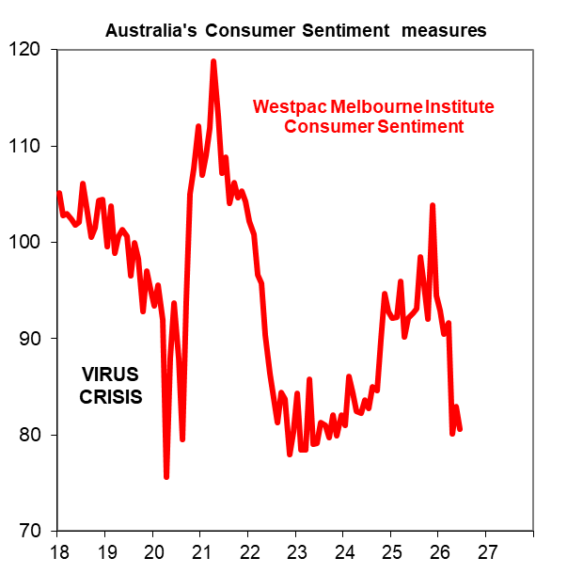
Australian Consumer Sentiment remains weak in June. A wall of worries include “cost of living” , “house price expectations” and “tax changes” with the Federal Budget
“ consumers remain deeply pessimistic. The sentiment shock that hit back in April eased off a touch in May but has intensified again in June. At 80.6, the latest monthly Index read is back amongst the weakest seen in the fifty-year history of the survey, pessimists outnumbering optimists by nearly 20%.
The survey detail shows cost-of-living issues remain front and centre, the temporary halving in fuel excise tax providing only a small and brief reprieve. Meanwhile, other concerns may be starting to emerge with a sharp drop in house price expectations suggesting some consumers are becoming more unsettled about the impact of recently announced tax changes. ”
Nov 103.8
80.6
June

Slide 32
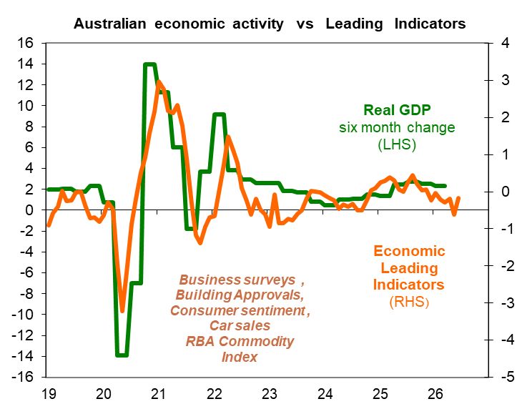

A broad measure of the Leading Indicators suggest the Australian economy is slowing
Mortgage Securities

Slide 33
Australia’s Reserve Bank (RBA) kept interest rates steady at 4.35 % at June's meeting as expected.
The key justification for this pause on interest rates are signs that Australia’s economic activity is slowing down sufficiently to moderate price pressures. The RBA noted that :
“ There are signs that growth in consumer spending is slowing as expected and momentum in the housing market has shifted, with housing prices falling in some capital cities. The unemployment rate was higher than expected in April, but other measures of labour market conditions have been more resilient”
The RBA highlighted the tighter “financial conditions” are now prevailing after three interest rate rises this year.
Yet the RBA also noted that “growth in business investment is strong and credit is readily available to both households and businesses.”.

Slide 34
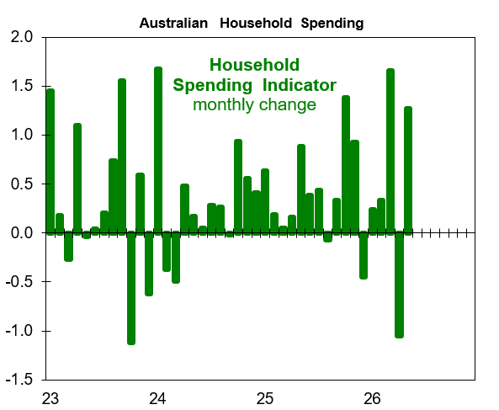
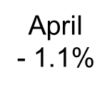
Australia’s nominal household spending showed another sharp swing in spending. However, the 1.3% rise in May largely reflects travel refunds. Higher mortgage interest rates and lower house prices in Sydney and Melbourne appears set to weigh on spending .
The ABS noted that :
“ Household spending rose 1.3 per cent in May 2026 .Transport spending rose by 1.4 per cent in May after falling 4.7 per cent in April. This was mostly due to travel related refunds….
“Excluding air transport spending, which was impacted by travel related refunds, total household spending would have risen 0.6 per cent.”
RBA Board statement for June
“ There are signs that growth in consumer spending is slowing as expected and momentum in the housing market has shifted, with housing prices falling in some capital cities.”
1.7% March
1.3 %
May

Slide 35
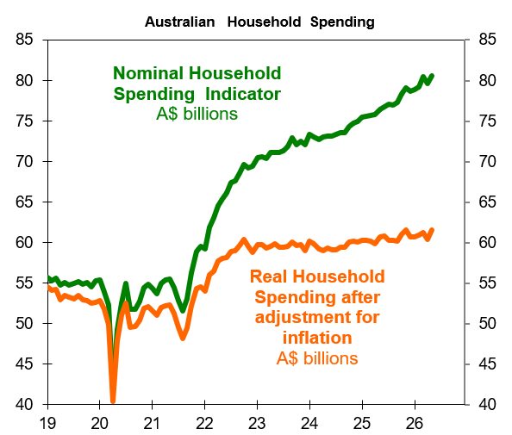
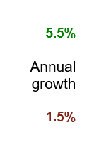
After adjusting for consumer inflation, Australia’s household spending shows only modest growth in real terms.

Slide 36
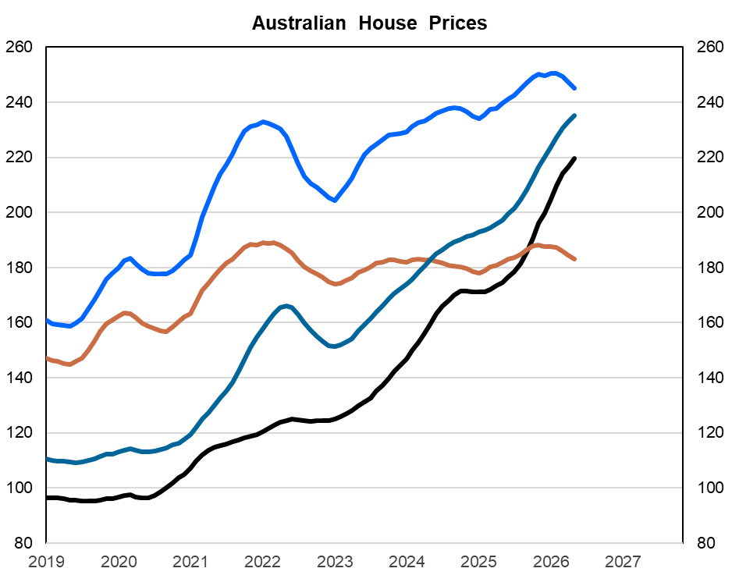

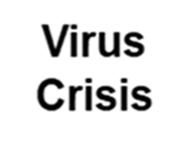
Australian house prices have entered a downturn given the RBA’s interest rate rises. Melbourne is down by - 3.4 % year to data and Sydney by – 3,2 % to the end of June.
House price gains since start of 2020 to June 2026
PERTH 128 %
BRISBANE 108 %
SYDNEY 36 %
Melbourne 13 %

Slide 37
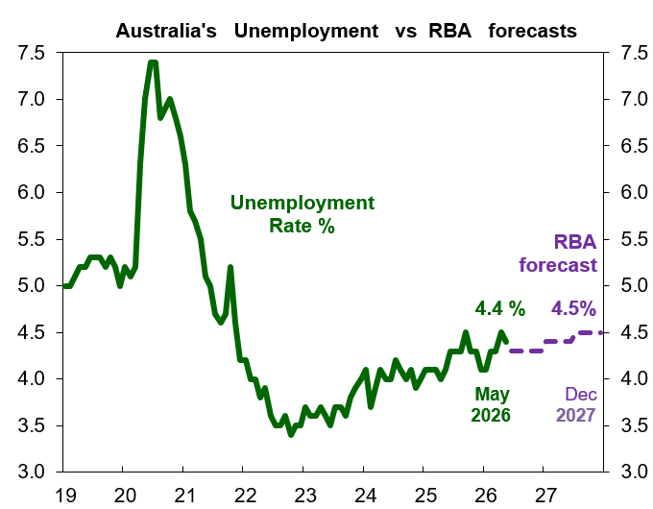
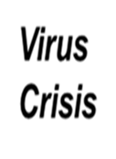
Australia’s labour data for May saw a revival. May’s job gains of circa +40 thousand came after April’s -41 thousand fall. The Unemployment rate edge down from 4.5 % to 4.4 %.
For the RBA, the labour market appears “ resilient ”.
RBA statement for June after leaving the cash interest rate steady at 4.35 % :
“The unemployment rate was higher than expected in April, but other measures of labour market conditions have been more resilient.”
AustLabour.xls

Slide 38
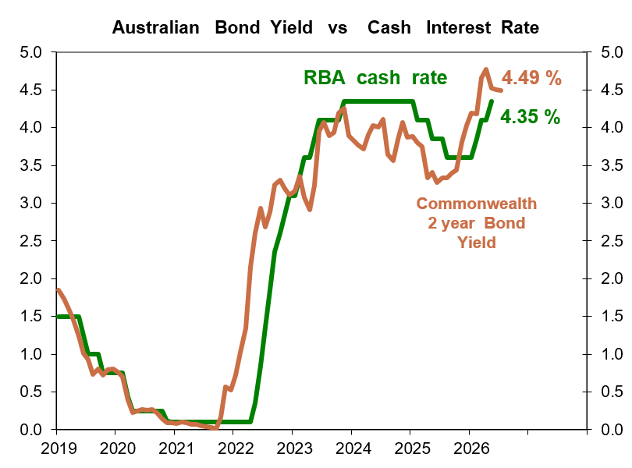
The bond market is leaning towards another RBA 0.25 % interest rate hike.

Slide 39
APPENDIX
39

Slide 40

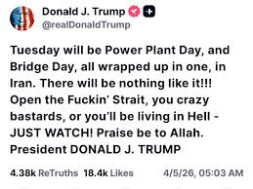
PRESIDENT TRUMP’s tirades to intimidate IRAN ….

Slide 41
“ Overconfidence ” and the Middle East war
“ Why did nations turn so often to war in the belief that it was a sharp and quick instrument for shaping international affairs when again and again the instrument had proved to be blunt or unpredictable ?
This recurring optimism is a vital prelude to war.
Anything which increases the optimism is a cause of war.
Geoffrey Blainey, The Causes of War (1973)

Slide 42
Impact of Military Conflicts and Oil Supply shocks on US economy and markets…. The 1979-80 Iran hostage crisis & revolution had less impact on US Shares because Wall Street’s S&P 500 in 1979 was actually below its 1973 level.
Episode | Headline CPI annual Year 1 start (Jan) | Headline CPI high over next 2 years | US recession timing NBER Cycle | Treasury 10 year Bond Yield at Year 1 start | Maximum High for Treasury Yield in Next 2 years | Treasury 10 year Bond maximum Move | S&P 500 at start of Year 1 | S&P 500 low during next 2 years | S&P 500 Maximum drawdown from start of Year 1
1973-74 Arab – Israeli War | 3.6 % | 12.3 % | Nov 1973 - March 1975 | 6.41 % | 8.16 % | + 1.55 | 120.2 | 62.3 | - 47 %
1979-80 Iran Revolution Iran – Iraq War | 9.3 | 14.8 | Jan 1980 – July 1980 | 9.15 | 13.65 | + 4.50 | 96.1 | 96.1 | 0
1990 -91 Iraq & Gulf War 1 | 5.2 | 6.3 | July 1990 – March 1991 | 7.93 | 9.04 | + 1.11 | 353.4 | 295.5 | - 16 %
2003-04 Gulf War 2 Iraq | 2.6 | 3.5 | No recession after March – Nov 2001 recession | 3.83 | 4.89 | + 1.06 | 879.8 | 800.7 | - 9.9 %
Average moves in above 4 episodes : Inflation up by 4%, Bond Yields rise 2% and S&P 500 falls -17 %

Slide 43



Conflicts in the Middle East have a history of providing a sharp cut in Global Oil supply that result in surging prices
James D Hamilton, University of California San Diego, Brookings paper (2016)
https://www.brookings.edu/wp-content/uploads/2016/07/2009a_bpea_hamilton-1.pdf

Slide 44
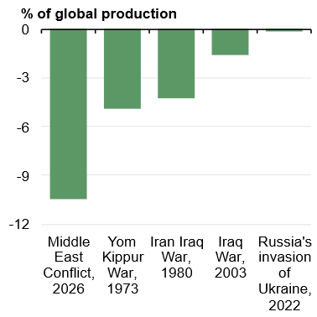
The current Middel East conflicts’ impact on global oil production is the largest on record going back to the 1970s
Fall in global oil production following major geopolitical shocks
“ The duration and severity of the conflict in the Middle East will determine the time it takes for production and shipping routes to recover. This will be critical to how the global economic outlook evolves.
The current conflict has already resulted in the largest global oil supply disruption on record. ”
Australian Federal Budget Paper 1 , page 51

Slide 45
The International Monetary Fund’s (IMF) warning in April that the Middle East conflict is damaging :
“The conflict has already inflicted humanitarian costs, damaged critical infrastructure, and severely disrupted maritime and air traffic in the affected region.
Economies around the world face repercussions through the direct impact of higher commodity prices, indirect second order effects on inflation expectations—which tend to be especially sensitive to energy and food prices—and amplification effects coming from risk-off sentiment in financial markets.
The global economic impact will crucially depend on the conflict’s duration, intensity, and scope, which are inherently unpredictable.”
IMF World Economic Outlook , Global Prospects and Policies, Chapter 1 , page 1
https://www.imf.org/-/media/files/publications/weo/2026/april/english/ch1.pdf

Slide 46
The International Monetary Fund’s (IMF) scenarios should the Iran War become “more protracted ” than a “ relatively short-lived conflict ”.
IMF “downside scenarios” for Global economy | ADVERSE SCENARIO | SEVERE SCENARIO
Oil prices | US$ 100 in 2026 US$ 75 in 2027 | US$ 110 in 2026 US$ 125 in 2027
Gas prices | Rise of +160 % in Q2:26 then “mostly unwinding” | +200 % rise
Food prices | Rises + 2.5 % in 2026 | +5 % rise in 2026 + 10 % in 2027
Global GDP growth impact | Reduces -0.8 % in 2026 and – 0.2 % in 2027 | Reduces -1.3 % in 2026 and – 1.0 % in 2027
Headline Consumer Inflation impact | Inflation rises by extra 1.5% in 2026 and 0.4% in 2027 | Inflation rises by extra 1.9% in 2026 and 2.6% in 2027

Slide 47

US Headline Consumer Inflation has accelerated on a monthly basis since the Iran War started in February.
Iran War starts
February 28
Since March,
Average Monthly change in consumer prices is +0.6 %.
Notionally this implies that
US inflation has risen by an extra 0.9 % since
March
Prior to War ,
Monthly % in Consumer prices was circa 0.3%

Slide 48

FED’s forecasts for this year are for the US economy to continue with solid growth, a stable unemployment rate but with core inflation staying well above the 2% target.
FED’s forecasts :
Solid US economic activity
Stable Unemployment Rate ….
Yet US Inflation is expected to remain above FED 2% target …
Hence the FED is under pressure to raise
interest rates …

Slide 49









Financial conditions yet to show significant tightening according to the FED Chicago NFCI
Since March 2023
financial conditions have become easier
- 0.5
July
2026
NFCI is a weighted average of a large number of variables (105 measures of financial activity)

Slide 50
The Reserve Bank (RBA) has two “adverse” scenarios. ADVERSE 1 scenario is
“smaller Demand impact ” vs ADVERSE 2 which sees “more impact ” on Aggregate Demand
Adverse scenarios for Australian Economy | “Smaller Demand” ADVERSE 1 Scenario | “More impact” ADVERSE 2 Scenario
Brent Crude Oil prices | “ Oil price peaks at around US$ 145 in Q2 2026 and gradually declines to around US$95 by June 2028 | “ oil price peaks at around US$ 145/bbl in Q2 2026 and gradually declines to around US$90/bbl ”
Asian Gas prices Currently US$ 16.9 | LNG price is assumed to reach US$30 MMBtu in Q3 2026 before declining to US$17 MMBtu | LNG price is assumed to reach US$30 MMBtu in Q3 2026 before declining to US$16 MMBtu
Australian GDP growth impact | The level of domestic GDP is around 0.5 per cent lower by mid-2028 than in the baseline forecast. | More than 0.8 % below the baseline forecast and 0.2 % below the first adverse scenario.
Consumer Inflation impact | Headline Inflation peaks at 5.2 % in June 2026. Trimmed Mean at 3.9% | Trimmed mean peaks at 3.9 % in June quarter of 2026

Slide 51

RBA’s “ADVERSE SCENARIOS” has inflation remaining high until next year .
A slowing Australian economy sees unemployment rise from current 4.3 % towards 5%

Slide 52

RBA’s reasoning on “greater capacity pressures” …
Actually, there has been only marginal changes in capacity pressures
recently as seen in the NAB Business survey and the jobless rate of 4.3 %
20 year average to Dec 2025
NAB
capacity
81.6
5.1%
Jobless
rate
81.9 %
4.3 %
Rising capacity utilisation and falling unemployment suggest inflation pressures

Slide 53

RBA’s assessment is that “most of the labour market indicators we monitor remain tighter than their estimated trend levels”.
Mortgage Securities

Slide 54

Australia’s Financial Conditions are still “restrictive” judging by a simple version of the RBA’s measures and methodology.
RBA Dr Chris Kent :
“We can also assess financial conditions by examining a broad set of indicators that complement the signals we take from the real economy.
ABA Banking Conference
Melbourne – 26 June 2024
This simple FCI version takes 9 out of the 10 suggested RBA measures to calculate Z scores for the period 2009-2023.
Excluded is the Business Interest Cover ratio

Slide 55

Higher mortgage interest rates are squeezing borrowers
6.6 %

Slide 56

Given three RBA interest rate rises this year, mortgage borrowers are back to paying nearly 10% of their disposable income in interest payments
Estimate 9.9% in Q2

Slide 57



Australia’s Productivity problem and the many reasons why !!!
Poor Management skills with resource allocation and delivering output
Lack of Investment in new Technology
Government Services are bureaucratic with low accountability and urgency amongst staff.
Work from Home (WFH) … are we actually doing the work hours ???
5 year average
Australia : GDP per hour worked
USA : Non -Farm Business sector Labour Productivity Source
Australian Bureau of Statistics and FED St Louis

Slide 58

RBA has highlighted that Productivity is constrained by regulations and skills availability
“ Contacts have reported in a survey on productivity that regulation and labour availability were key barriers to lifting their productivity growth over the past five years.
Firms said that the complexity, cumulative volume and frequency of change in regulation has been hard to manage, particularly for smaller firms.
The large share of firms identifying employee skills and availability as a barrier over the recent period cited the significant turnover in the labour market, much higher wage expectations and the inability to attract specific skills when needed as factors weighing on productivity.”
RBA SMP Aug 25 , page 45

Slide 59

Australian Federal Budget 2026/2027 noted on page 137 :
“As housing prices rise faster than income, access to home ownership increasingly depends on the wealth of the previous generation – ‘the bank of mum and dad’. This entrenches higher levels of wealth inequality across generations. Home ownership has declined, with 3 per cent fewer Australians owning a home than in 1981 “
Housing prices-to-earnings ratio
Share of households owning home
Housing prices are median sales AVM value (Cotality Data) and earnings are average adult full-time ordinary time earnings (ABS).
Australian Federal Budget Paper 1 , page 138

Slide 60

“ Declines in home ownership have been most significant for younger Australians.
Home ownership for people aged 25–34 fell by 7 percentage points in the two decades from 2001 to 2021 and 17 percentage points since 1981.
In 2021, only half of people aged 30–34 and about one third of those aged 25–29 owned their own home
Australian Federal Budget 2026/2027 then highlighted on page 138 & 139
Home ownership rates are declining, particularly for younger Australians Home ownership rates, by age group

Slide 61



Australia’s new housing construction has been subdued despite a sharp increase in population in the past four years.
Housing shortage with population increases exceeding new housing construction

Slide 62

Australian Corporate Bonds and Term Deposits offer higher gross yields compared to Australian Shares
5.3 %
5.0 %
2.9 %

Slide 63

Australian Dollar gains have faded against the US Dollar. Australian bond yields are higher than the United States but the margin has declined from 0.8 % to 0.3%.

Slide 64
President Trump in April 2025 :
“ I always say ‘ tariffs' is the most beautiful word to me in the dictionary ” *
Tariffs | 2024 under President Biden | Trump’s ‘Liberation Day April 2 to April 8 2025 | Latest April 2026
AUSTRALIA | 0 % | 10 % | 10 %
EUROPE | 2 % | 20 % | 15 %
CHINA | 16 % | 145 % | 20 %
JAPAN | 2 % | 25 % | 15 %
Aluminium & Steel | 25% China & Mexico | 25 % all countries | 50 % All
Pharmaceuticals | N/A | 0 % | 100 %
USA Effective Tariff rate | 2.4 % | 24 % | 11.8 %
Source NPR https://www.npr.org/2025/04/09/nx-s1-5355661/tariffs-history-meaning , World Trade Organisation for 2024 data World Tariff Profiles
and Yale University Budget Labs

Slide 65

“Back to the Future” for US trade policy : American consumers confront an “average effective tariff rate of 17.9 % according to the Yale University’s Budget Lab.
16.9 %
Source
Yale University Budget Lab : https://budgetlab.yale.edu/research/state-us-tariffs-july-14-2025

Slide 66
Moody’s downgraded the US government credit rating from AAA to Aa1 with a negative outlook in May 2025 with the following rationale :
“ Successive US administrations and Congress have failed to agree on measures to reverse the trend of large annual fiscal deficits and growing interest costs. We do not believe that material multi-year reductions in mandatory spending and deficits will result from current fiscal proposals under consideration.
Over the next decade, we expect larger deficits as entitlement spending rises while government revenue remains broadly flat. In turn, persistent, large fiscal deficits will drive the government's debt and interest burden higher. The US' fiscal performance is likely to deteriorate relative to its own past and compared to other highly-rated sovereigns.
As a result, we expect federal deficits to widen, reaching nearly 9% of GDP by 2035, up from 6.4% in 2024, driven mainly by increased interest payments on debt, rising entitlement spending, and relatively low revenue generation. We anticipate that the federal debt burden will rise to about 134% of GDP by 2035, compared to 98% in 2024.”
https://ratings.moodys.com/ratings-news/443154

Slide 67





USA has been running large budget deficits since Clinton’s last year in the White House in 2020 Moody’s forecast is just another warning over the lack of fiscal discipline.
Clinton
2000
Moody’s forecast “reaching nearly 9% of GDP by 2035, up from 6.4% in 2024 ”
BIDEN
21-25
- 9 % in 2035
TRUMP
2017-21

Slide 68

US budget analysis typically focuses on the “Total Debt held by the Public” which is “Gross Government Debt less the intragovernmental holdings”
121 %
96 %
Debt held by the Public excludes “intra government holdings” which is debt is held by “Social Security, Medicare, and other federal programs “” that “purchase Treasury debt for their trust funds.” according to the US Treasury
Understanding the National Debt | U.S. Treasury Fiscal Data

Slide 69



Given the “ big beautiful bill ” CBO estimates that the US public debt will accelerate higher from their prior estimate of 117% to 125 % in 2034 .
2034 projection
125 %
117 %
CBO
June 2025
Biden
2021-25
96 %
https://www.cbo.gov/system/files/2025-06/61459-Debt-Service.pdf

Slide 70
Can the USA have a “fiscal crisis” ? There are many paths to a fiscal crisis but ultimately the destination is devastating.
A fiscal crisis is “ a sudden, large, and persistent downturn in demand for Treasury securities relative to supply that triggers a sharp and persistent spike in interest rates. Such a rise in interest rates on Treasuries would most likely precipitate a crisis in “the global financial system” .
Brookings suggested four possible scenarios involving inflation risks, political brinkmanship , FED changing their inflation target and finally the deterioration in “long term fiscal outlook”
Demand or supply of Treasuries could abruptly shift for reasons unrelated to inflation or default risk such that interest rates spike, causing financial market disruptions that the Federal Reserve is unable or unwilling to mitigate.
Investors could come to believe that the U.S. Treasury might default on interest or principal payments because of political brinkmanship, and policymakers would be unable or unwilling to regain credibility.
The Federal Reserve could be perceived as abandoning its mandate to preserve price stability and instead allowing for hyperinflation.
The long-term fiscal outlook could deteriorate so significantly and so sharply that investors abruptly worry about some form of default, leading them to abandon Treasuries until policymakers take actions to rein in deficits.
https://www.brookings.edu/articles/assessing-the-risks-and-costs-of-the-rising-us-federal-debt
/

Slide 71

US Government term premiums have risen sharply over recent years to compensate for perceived credit and duration risk ( essentially higher risk premiums )
Term premium is
“compensation that investors require for bearing the risk that interest rates may change over the life of the bond.
Since the term premium is not directly observable, it must be estimated, most often from financial and macroeconomic variables. ”
FED NY
https://www.newyorkfed.org/research/data_indicators/term-premia-tabs#/overview
Dot.Com
GFC
Pandemic
July
0.7 %

Slide 72

Compared to USA, Australia shows more fiscal discipline with lower government debt
US Gross Debt could climb to +140% of GDP in 2025 according to the Congressional Budget Office analysis of the Republican Party’s One Big Beautiful Bill passed in July
121 %
49 %

Slide 73

China’s residential property market remains a major concern according to the Reserve Bank (RBA).
“Conditions in the Chinese housing market remain very weak. Prices and sales of new housing (which makes up most of overall housing transactions) have declined further over recent months.
Chinese banks, and particularly rural commercial banks, maintain material direct exposures to the property sector. Risks to banks from the mortgage book are mitigated by moderate loan-to-valuation ratios.
Nevertheless, property developers remain under heavy pressure; many are imposing deeper haircuts on creditors amid a recent rise in debt restructurings, reflecting limited cash flows and deteriorating asset valuations. Household vulnerabilities also remain elevated as property prices have declined and household income growth is slowing. ”
Source : RBA Financial Stability Review , October 2025 page 5 (RBA)

Slide 74

A China – Taiwan War would have parallels to Russia – Ukraine in terms of a large attacker against a small nation. The question is - Does the United States then defend Taiwan ?
BBC analysis :
“ President Xi Jinping has said "reunification" with the island must be fulfilled and is believed to have a deadline. In a military confrontation, China's armed forces would dwarf those of Taiwan.”
 | CHINA | TAIWAN
Active Soldiers | 2 million | 169 thousand
Fighter aircraft | 3,438 | 531
Tower Artillery | 9,752 | 2,093
Taiwan sits in the so-called "first island chain", which includes a list of US-friendly territories that are crucial to Washington's foreign policy in the region.
Source ; The Military Balance , ISS & BBC
https://www.bbc.com/news/world-asia-china-59900139

Slide 75

Russia – Ukraine War appears to be a stalemate with Russia holding eastern Ukraine & Crimea despite Ukraine’s brave defence
UKRAINE has a smaller defence force than Russia yet has still managed to inflict more casualties.
 | RUSSIA | UKRAINE
Active Soldiers | 1.32 million | 0.9 million
Fighter aircraft | 809 | 72
Tower Artillery | 8,356 | 1,012
Casualties Killed, Wounded & Missing | + 1.2 million | + 100 to + 140 thousand
Source ; Harvard University & DW Media

